Slide 1

Afcoe.org

Slide 2


Slide 3
Our Greatest Need

Slide 4
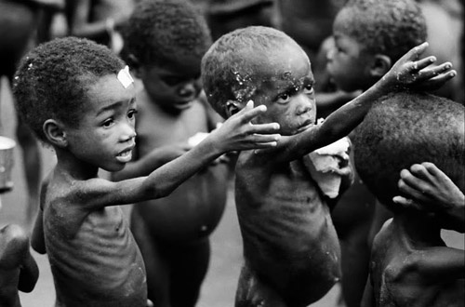

Slide 5


Notes:
Originally published in 1969, the documentary evidence of poverty and malnutrition in the American South showcased in Still Hungry in America resonates today.

Slide 6
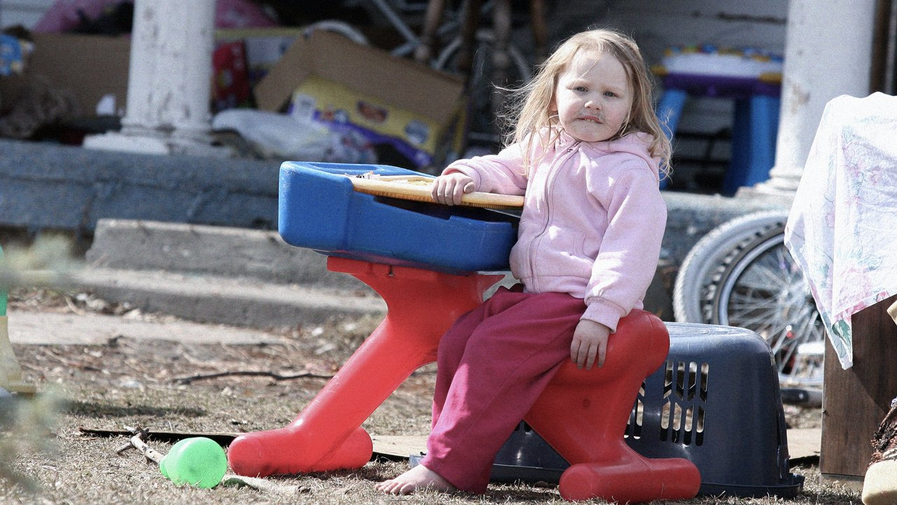
Notes:
Originally published in 1969, the documentary evidence of poverty and malnutrition in the American South showcased in Still Hungry in America resonates today.

Slide 7
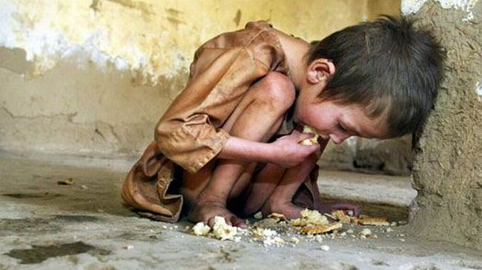

Slide 8
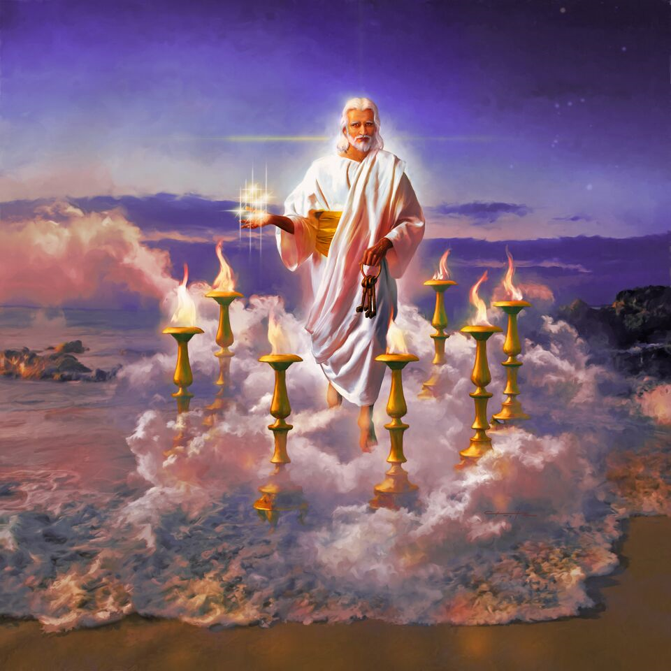

Slide 9

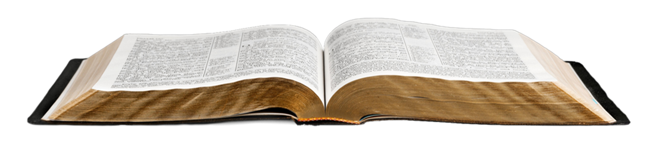
Go therefore, and make disciples of all the nations: baptizing them…
teaching them to observe all things that I have commanded you.
Matthew 28:18-20

Slide 10
This Gospel of the Kingdom
will be preached in all the world
as a witness to all the nations,
and then the end will come.
Matthew 24:14

Slide 11
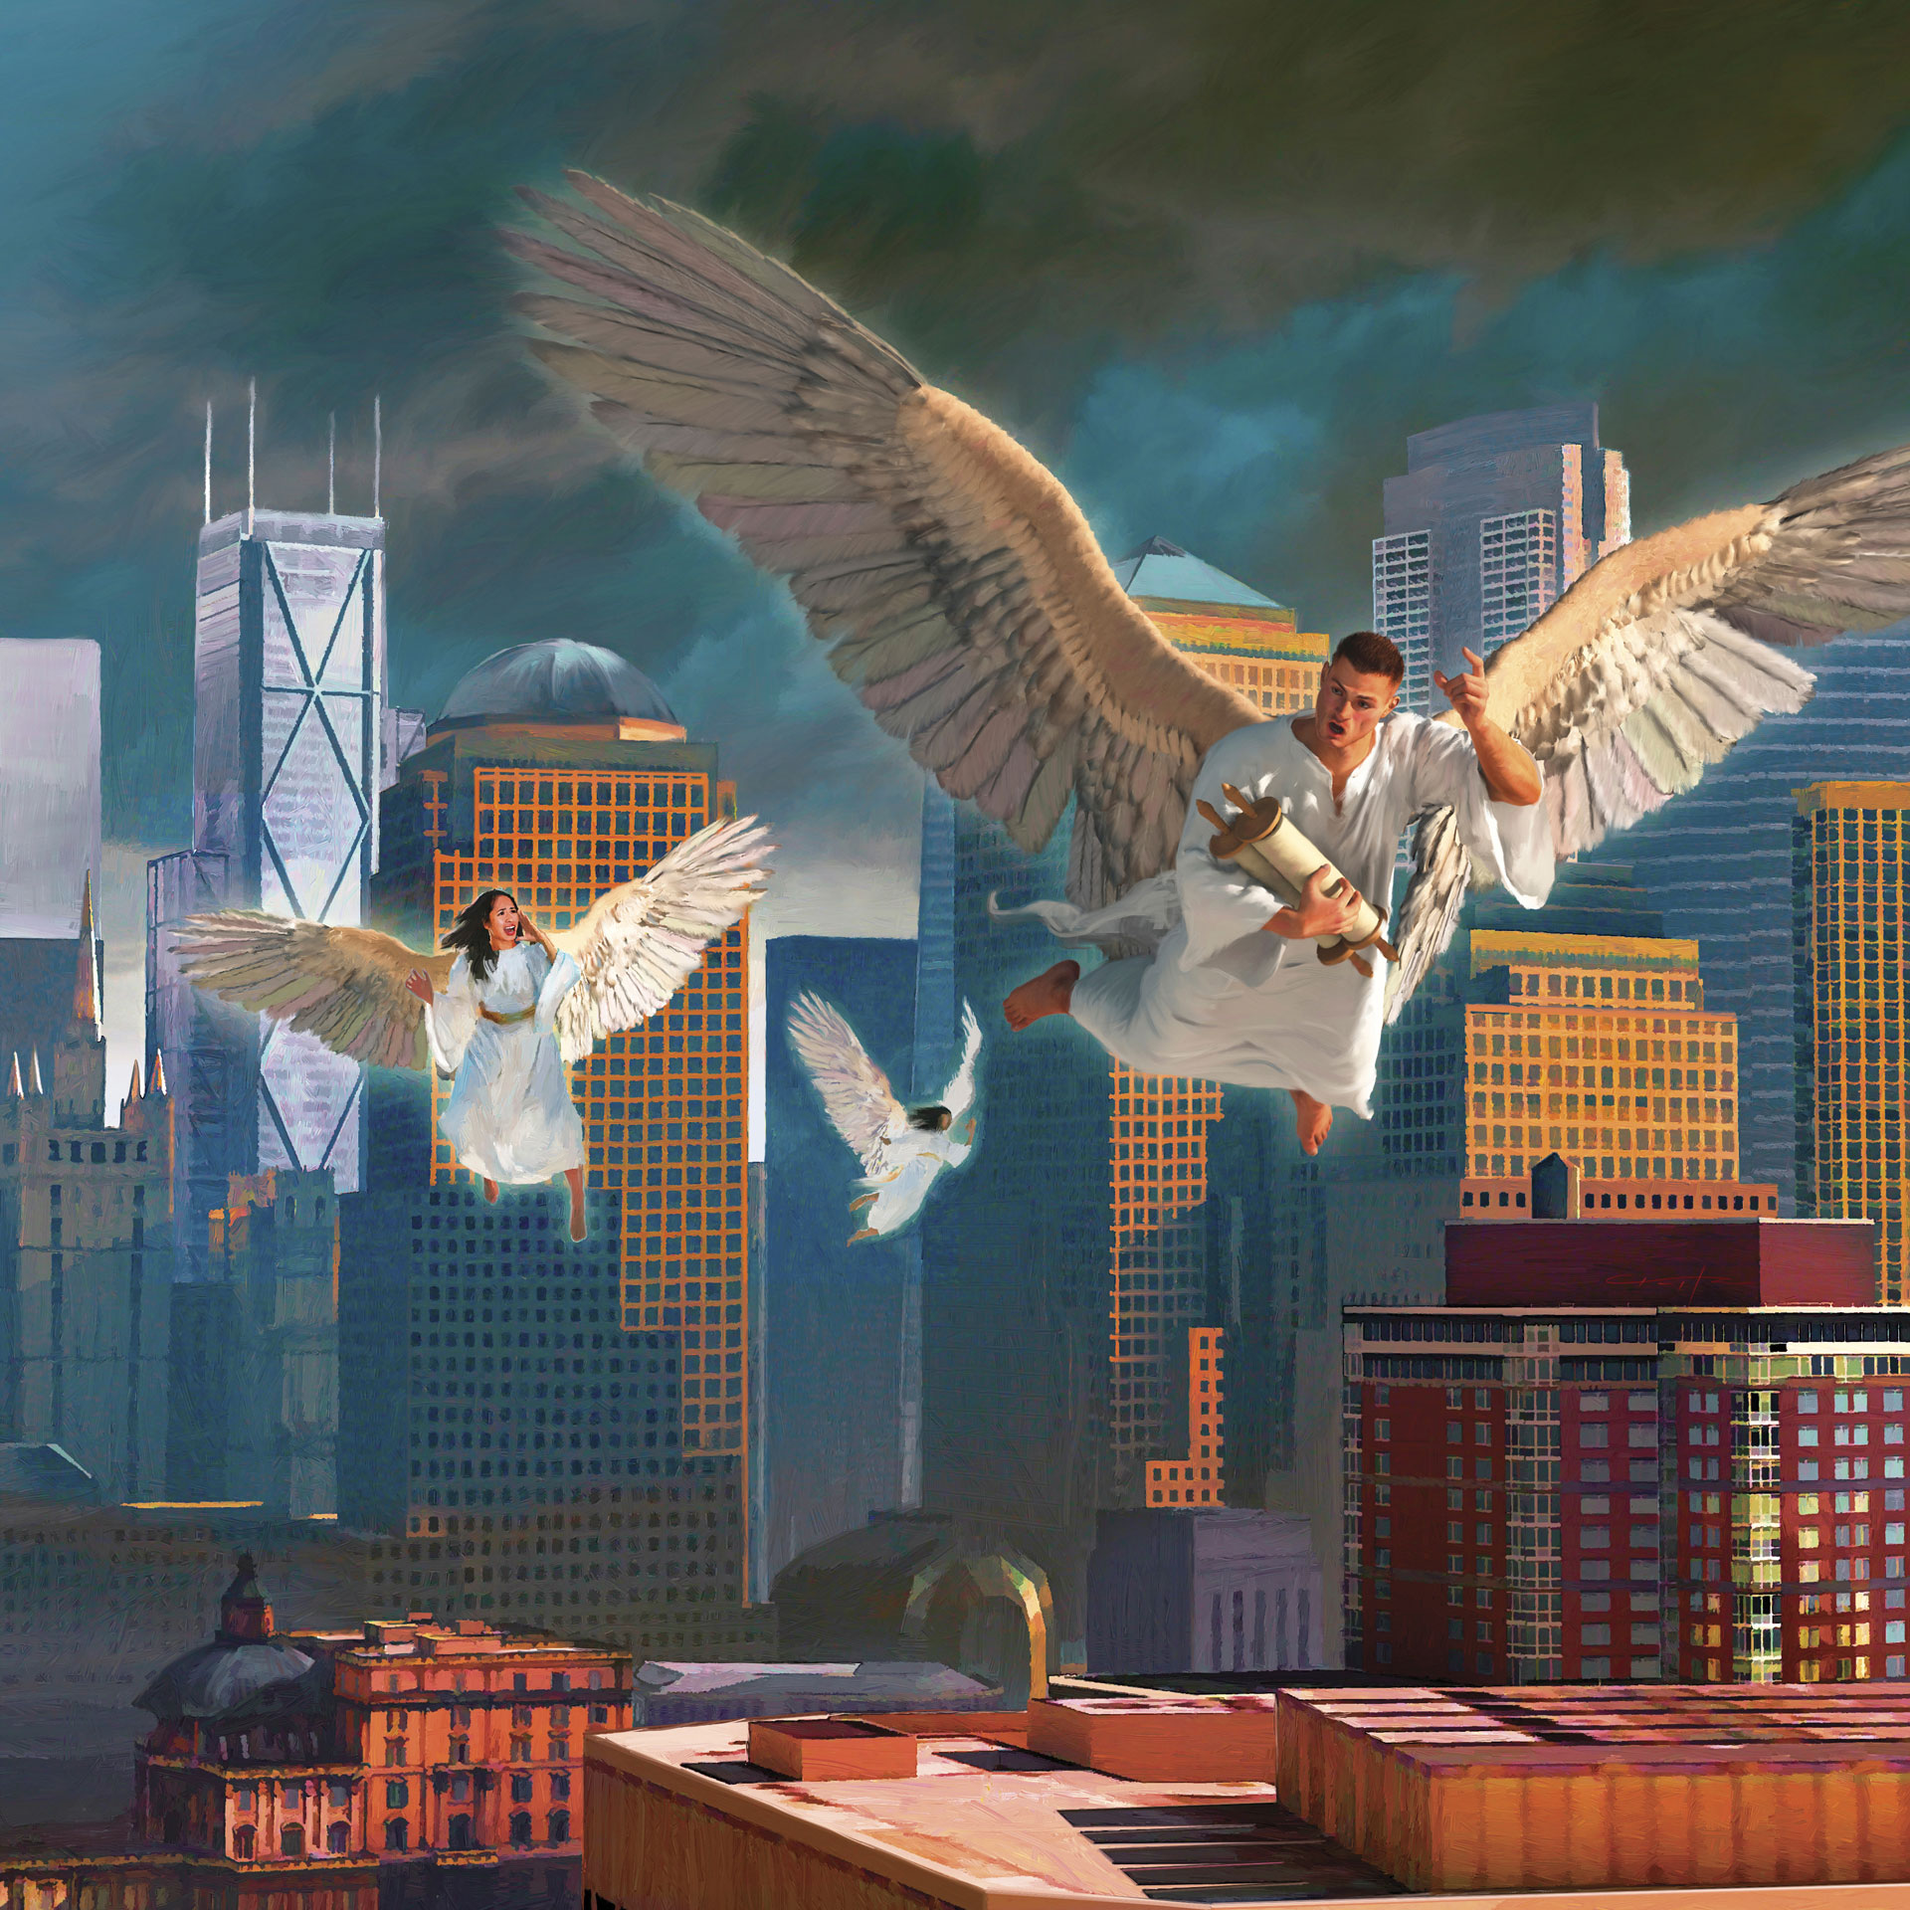
The Everlasting Gospel
Revelation 14:6-12

Slide 12
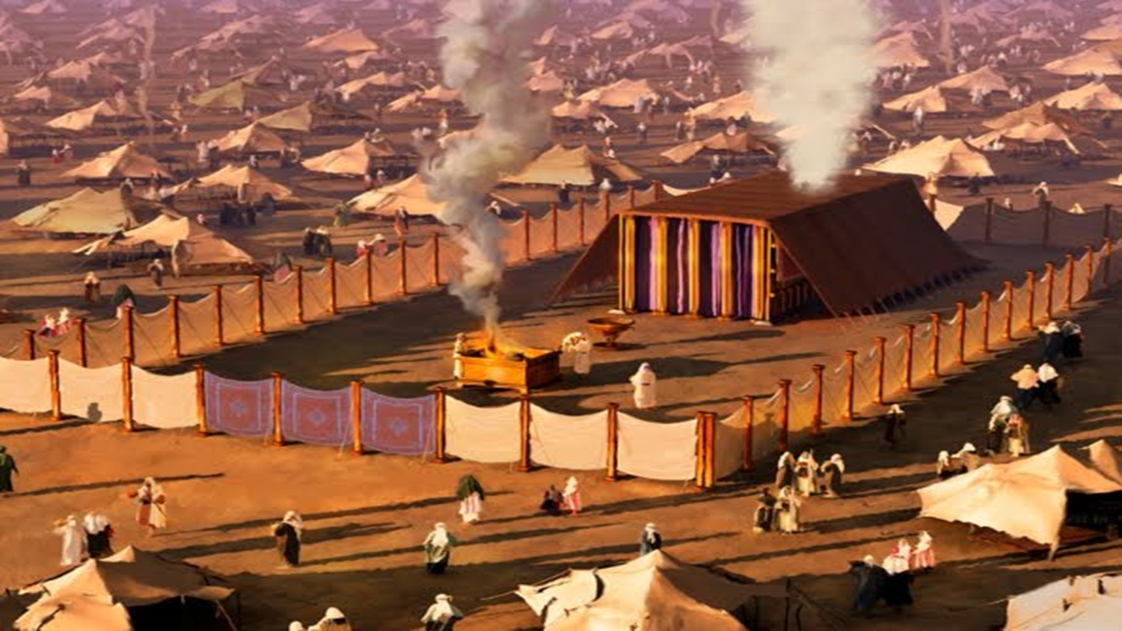

Slide 13
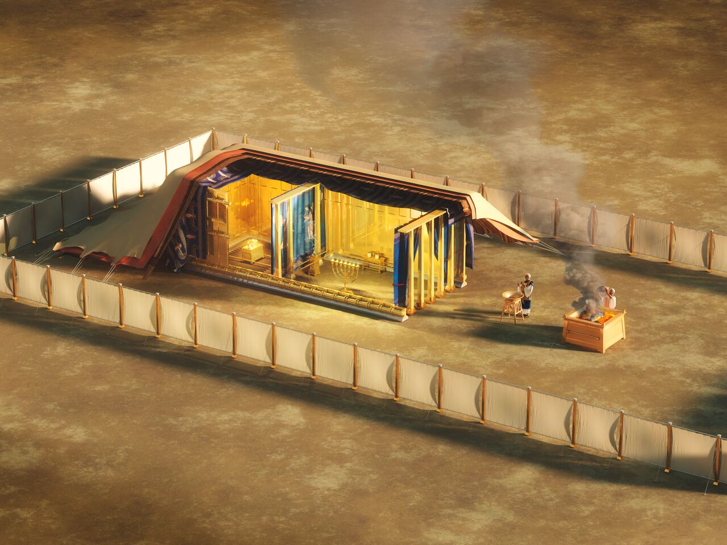

Slide 14

Evangelism Cycle
(Personal & Church)

Slide 15
Evangelism Cycle
(Personal & Church)
1. Daily Communion:
Prayer & Study Life

Slide 17
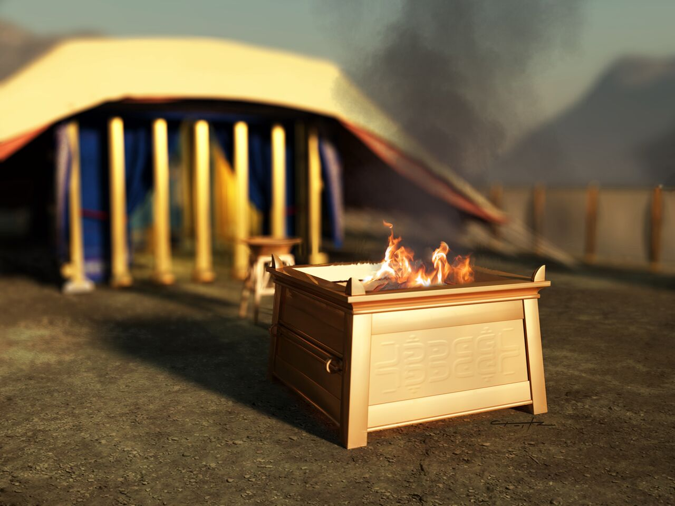

Slide 19
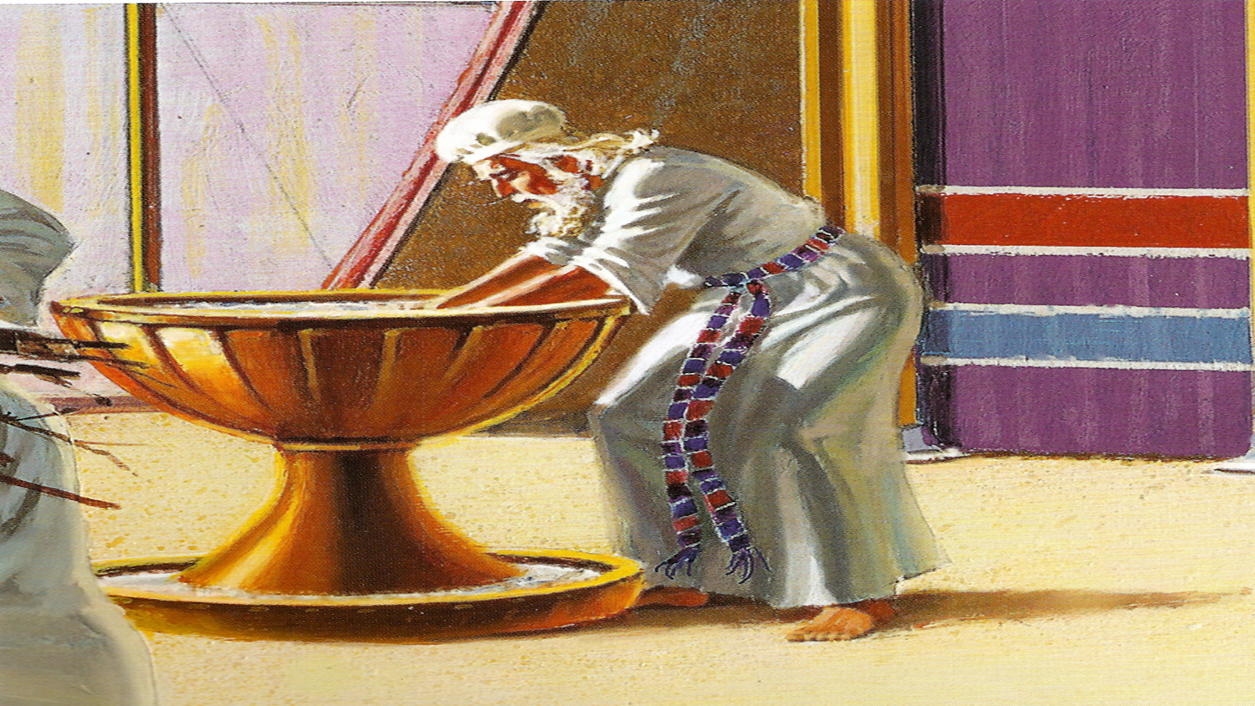

Slide 20
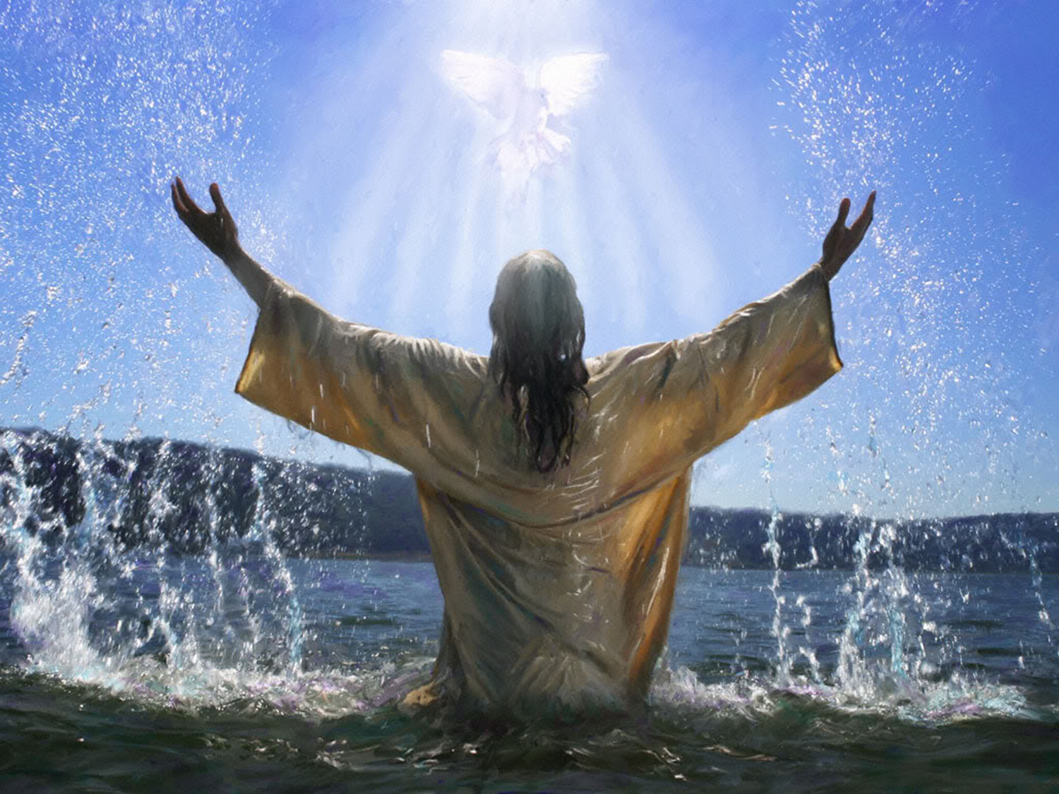

Slide 21
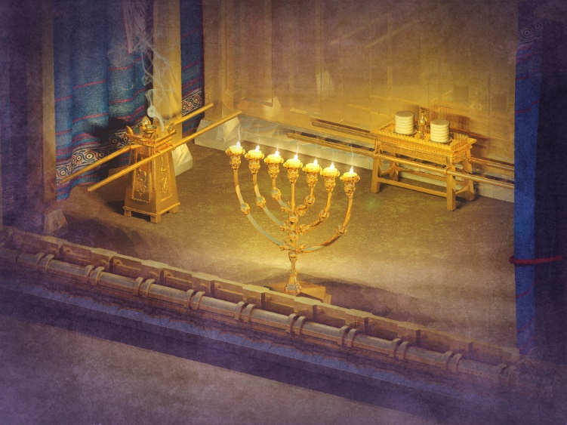

Slide 22
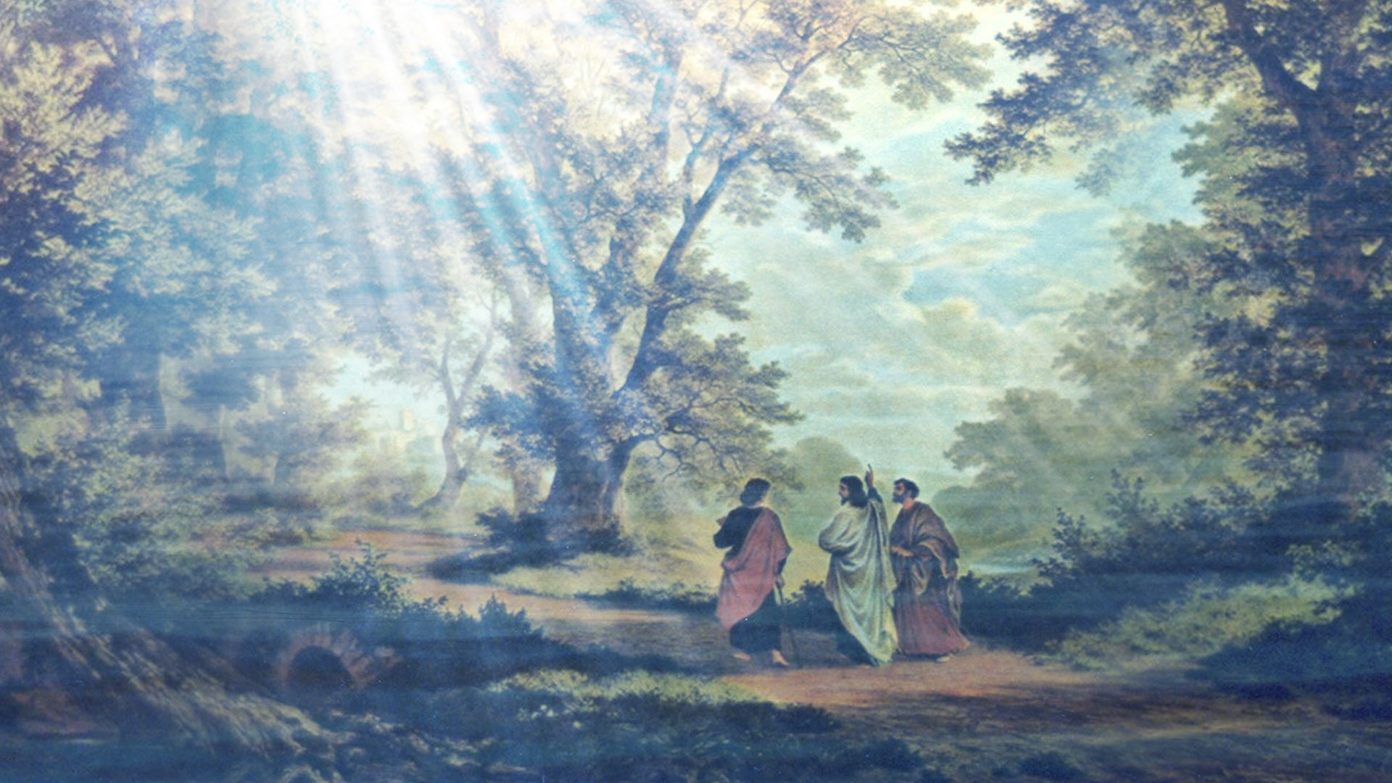

Slide 23
“The daily study of the Bible is the path to growth; not study as a duty, but as the wonderful experience of being in communion with Jesus.
The Bible is the love letter that Jesus wrote to you.
It is the way to communicate with you,
to show you the dangers of the road,
to teach you the paths of justice and to lead you
to the glorious destiny that He has prepared you.”
Notes:
Originally published in 1969, the documentary evidence of poverty and malnutrition in the American South showcased in Still Hungry in America resonates today.

Slide 25
Christ’s Object Lessons
Ch. 25 “Talents”
Far more might be accomplished in the work of self-education if we were awake to our own opportunities and privileges. True education means more than the colleges can give. While the study of the sciences is not to be neglected, there is a higher training to be obtained through a vital connection with God…

Slide 26
Let every student take his Bible and place himself in communion with the great Teacher. Let the mind be trained and disciplined to wrestle with hard problems in the search for divine truth.”

Slide 28
A revival of true godliness among us is the greatest and most urgent of all our needs.
To seek this should be our first work.
Notes:
Originally published in 1969, the documentary evidence of poverty and malnutrition in the American South showcased in Still Hungry in America resonates today.

Slide 29
A revival of true godliness among us is the greatest and most urgent of all our needs.
To seek this should be our first work.
There must be earnest effort to obtain the blessing of the Lord, not because God is not willing to bestow His blessing upon us, but because we are unprepared to receive it…
Notes:
Originally published in 1969, the documentary evidence of poverty and malnutrition in the American South showcased in Still Hungry in America resonates today.

Slide 30
Our Heavenly Father is more willing to give his Holy Spirit to them that ask Him, than are earthly parents to give good gifts to their children.
But it is our work, by confession, humiliation, repentance, and earnest prayer, to fulfill the conditions upon which God has promised to grant us His blessing. A revival need be expected only in answer to prayer. (RH 3/22/1887)
Notes:
Originally published in 1969, the documentary evidence of poverty and malnutrition in the American South showcased in Still Hungry in America resonates today.

Slide 32
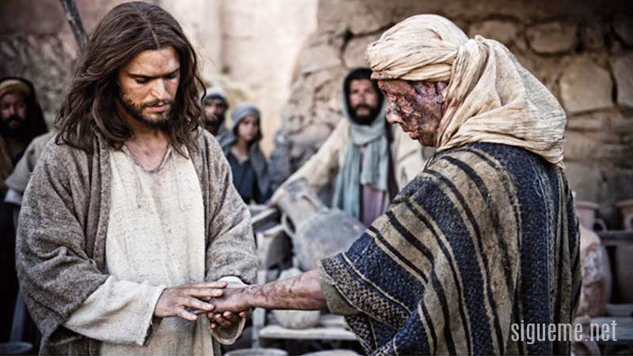

Slide 33
Prophets and Kings
Chap. 18 - The Healing of the Waters
“The transformation of character is the testimony to the world that Christ dwells in the believer. When holding the thoughts and desires to the will of Christ (Prayer and Study of the Word)
the Spirit of God brings new life in us and our character is renewed in the image of God.”
Notes:
Originally published in 1969, the documentary evidence of poverty and malnutrition in the American South showcased in Still Hungry in America resonates today.

Slide 34
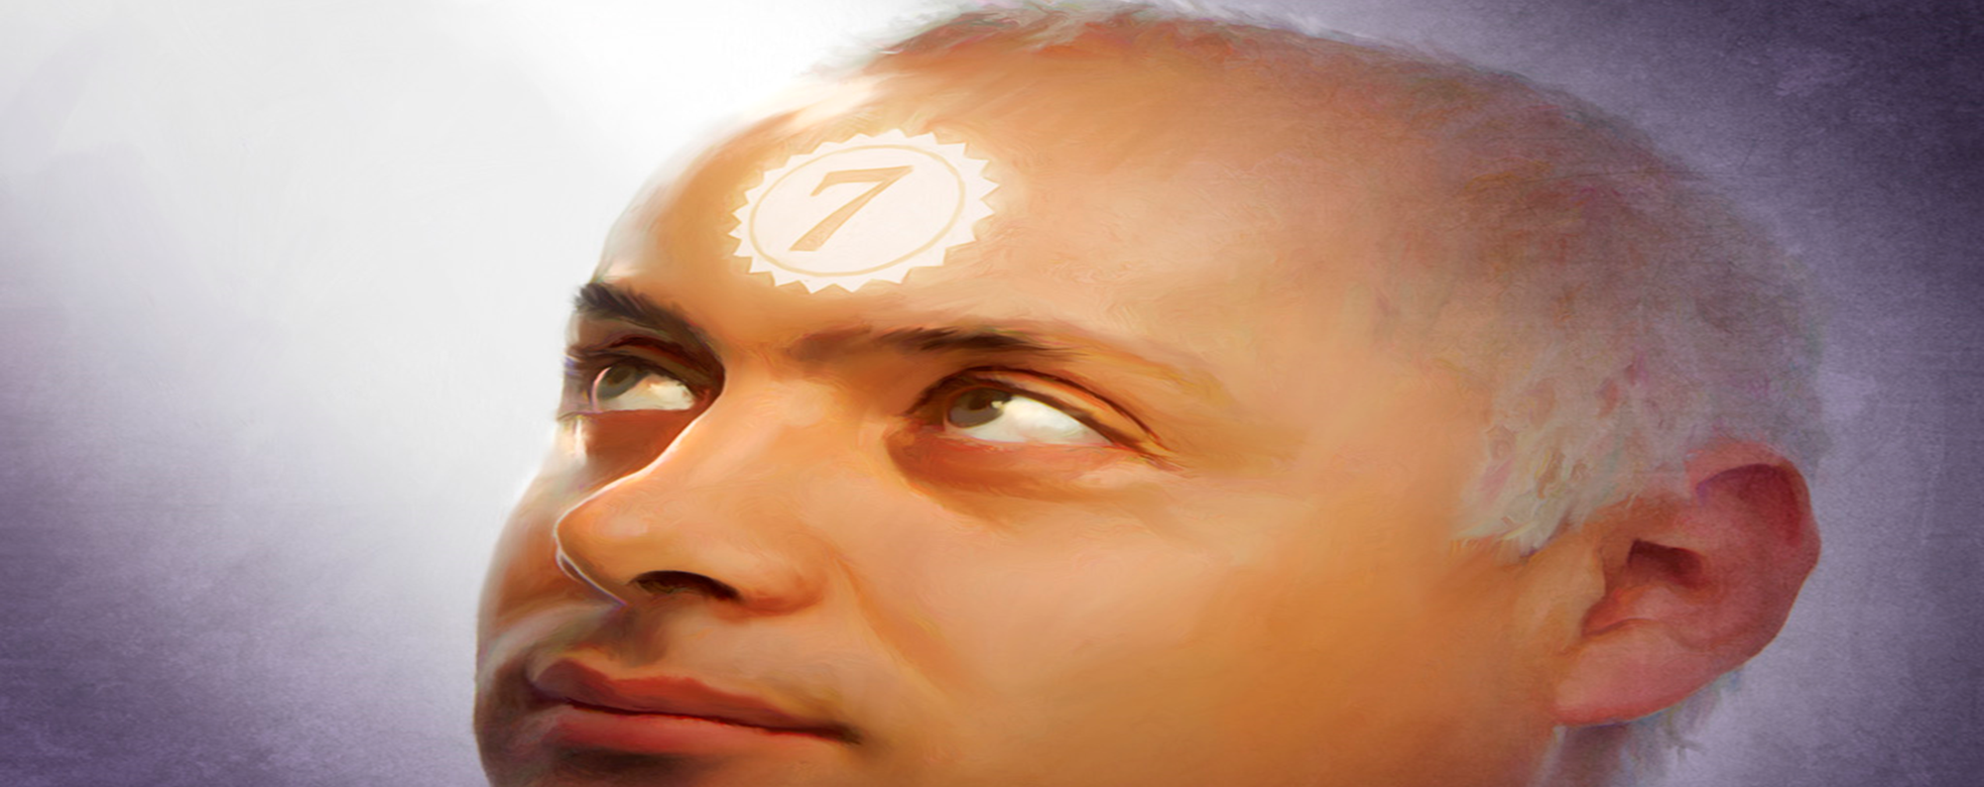

Slide 39
Jesus recognized Martha’s desire to serve Him but she allowed this to be a distraction from what comes first: Before we are ready to serve Him we must first be at His feet/disciple!!!! Service doesnt bring peace only Christ but when we are at His feet we will serve Him!
Lucas 10:38-42
“María, la cual, sentándose a los pies de Jesús, oía Su palabra…Pero Marta se distraía en muchos servicios…Marta, Marta, estás afanada y turbada con muchas cosas: Pero una cosa es necesaria; y María ha escogido la buena parte,
la cual no le será quitada.”

Slide 40
A revival of true godliness among us is the greatest and most urgent of all our needs. To seek this should be our first work. There must be earnest effort to obtain the blessing of the Lord, not because God is not willing to bestow his blessing upon us, but because we are unprepared to receive it. Our Heavenly Father is more willing to give his Holy Spirit to them that ask him, than are earthly parents to give good gifts to their children. But it is our work, by confession, humiliation, repentance, and earnest prayer, to fulfill the conditions upon which God has promised to grant us his blessing. A revival need be expected only in answer to prayer. While the people are so destitute of God's Holy Spirit, they cannot appreciate the preaching of the word; but when the Spirit's power touches their hearts, then the discourses given will not be without effect. Guided by the teachings of God's word, with the manifestation of his Spirit, in the exercise of sound discretion, those who attend our meetings will gain a precious experience, and returning home will be prepared to exert a healthful influence. {RH, March 22, 1887 par. 1}

Slide 41
Que hizo Maria que le trajo paz a ella y no a Martha?
Isaías 26:3,4
“Tú guardarás en completa paz,
a aquel cuyo pensamiento
en Ti persevera;
porque en Ti ha confiado. Confiad en el Señor siempre; porque en el Señor está la fortaleza eterna.”

Slide 42


Slide 43


Slide 44
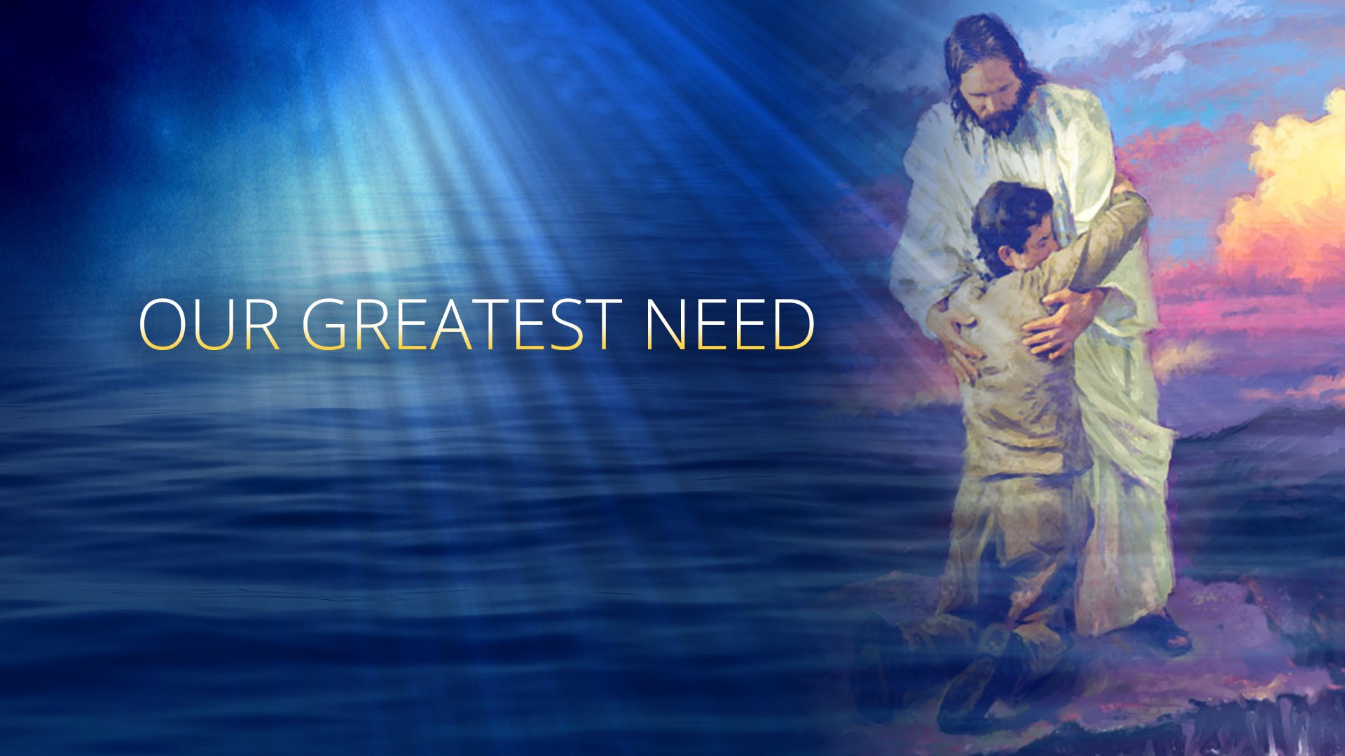

Slide 45

WHAT ARE THE FIRST STEPS I NEED TO DO TO FULFILL THE GREAT COMMISSION????

Slide 46
Mas buscar primeramente el Reino de Dios y Su justicia, y todas las cosas os serán añadidas.”

Slide 47
SALMO 51:1-13
2 Cron 7:14

Slide 48
A revival of true godliness among us is
the greatest and most urgent of all our needs.
To seek this should be our first work.
Last Day Events Ch. 13 “Tha Latter Rain” (1SM pg 121)

Slide 49
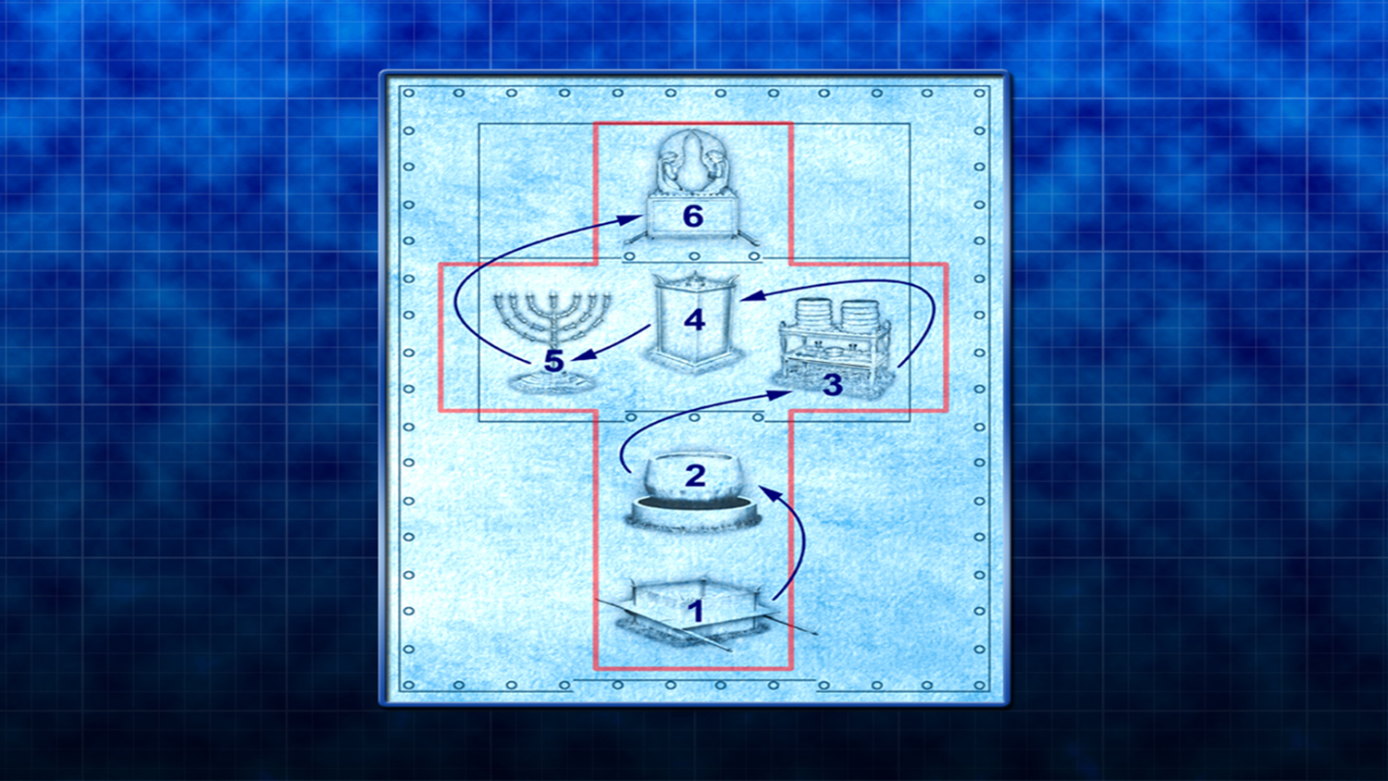

Slide 50
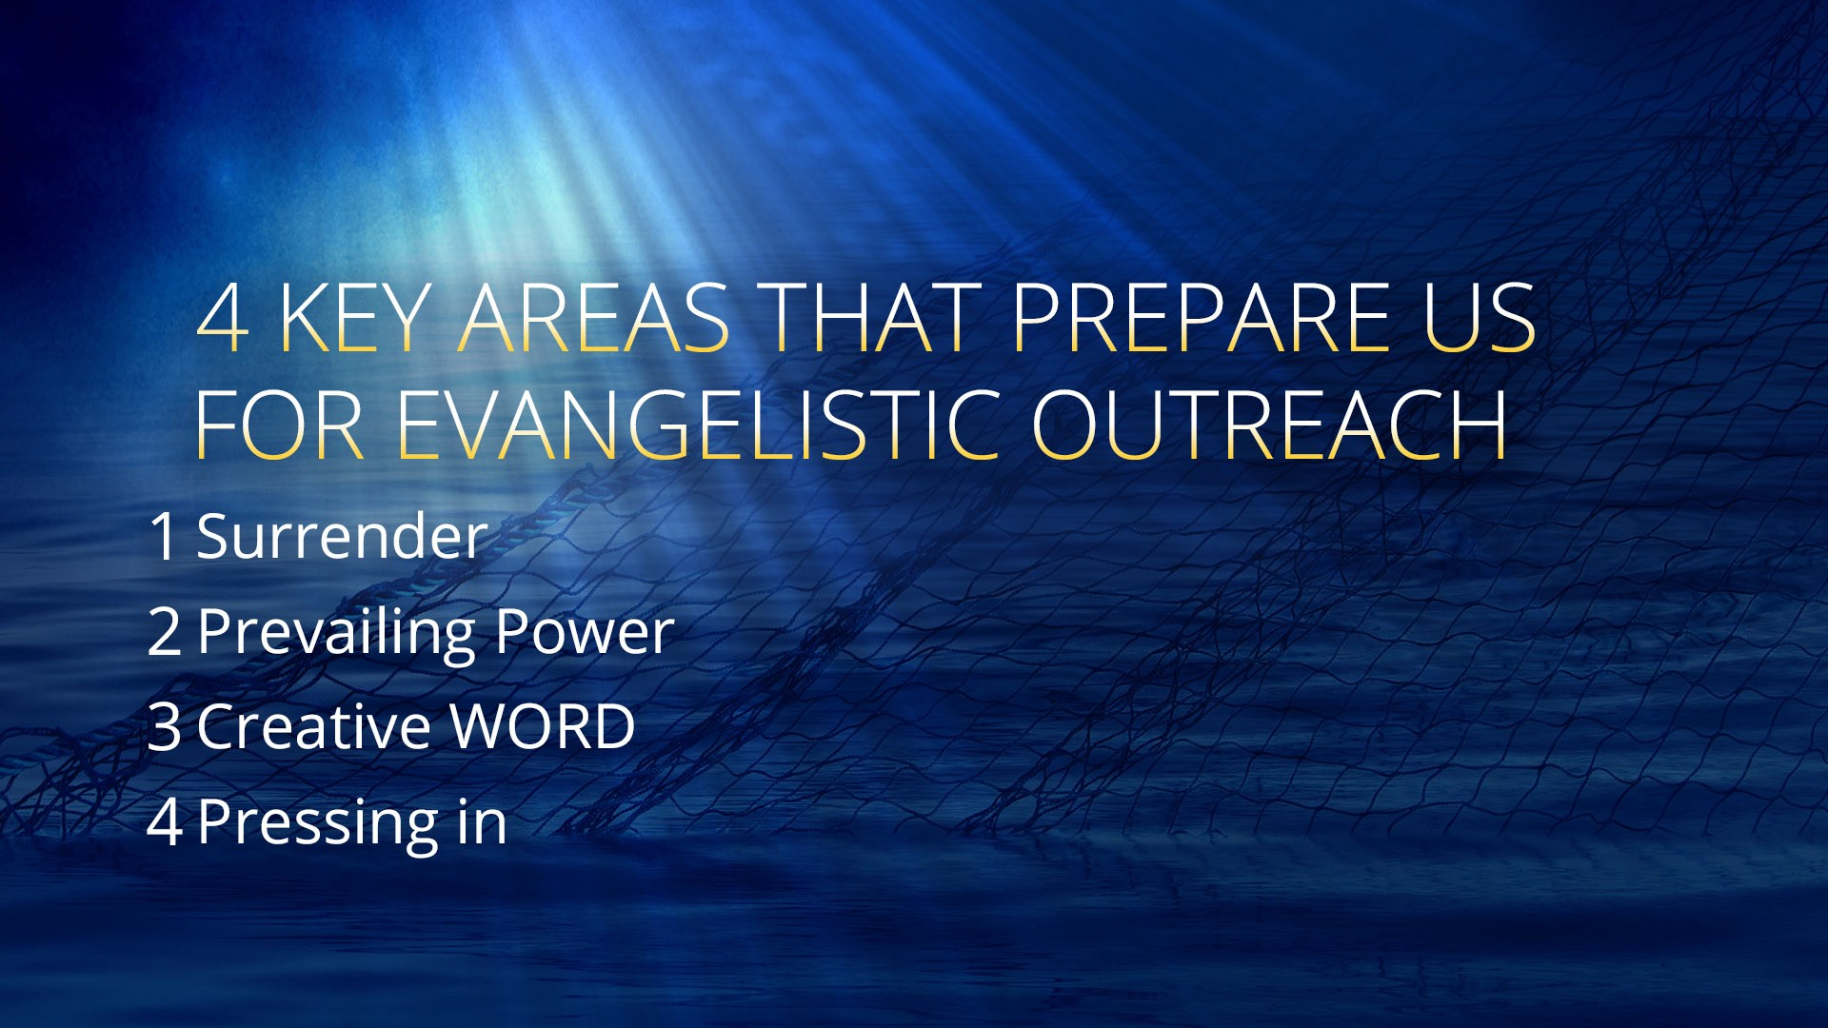

Slide 51
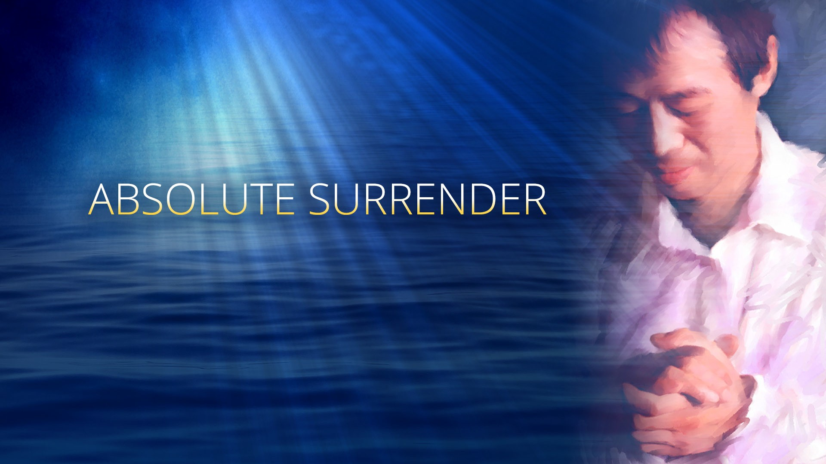

Slide 52
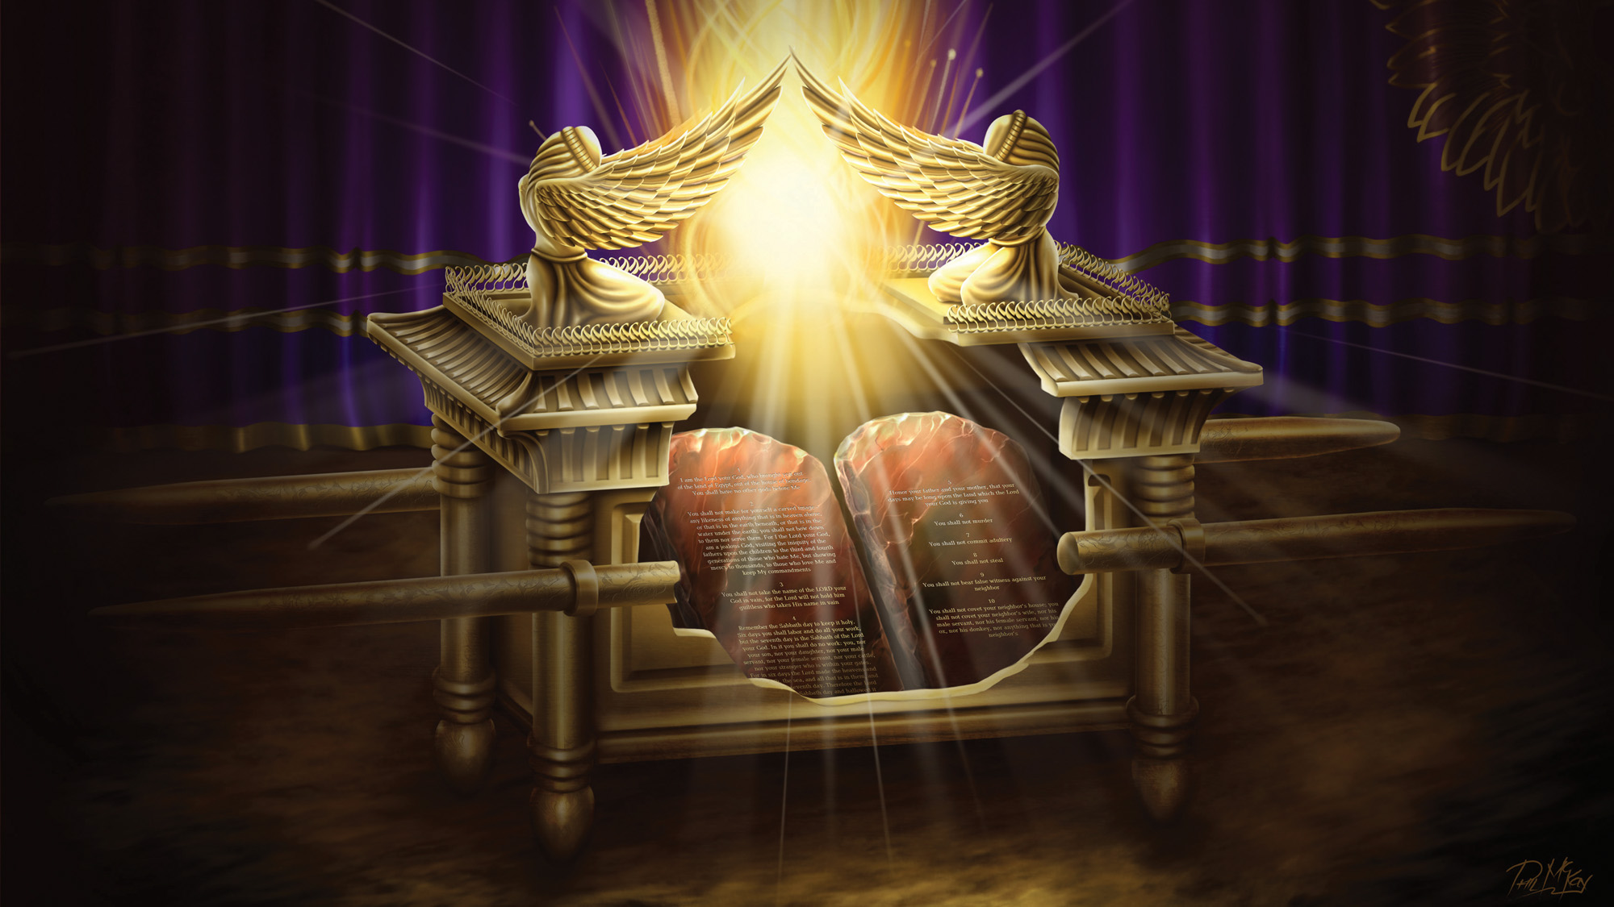

Slide 53
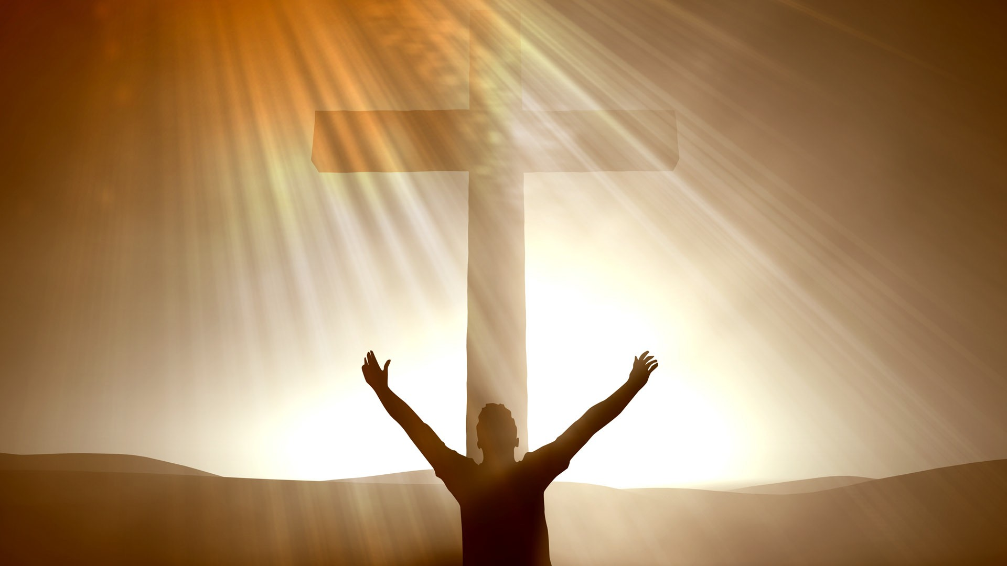

Slide 55
But you shall receive power when the Holy Spirit has come upon you; and you shall be witnesses to Me both in Jerusalem, and in all Judea, and Samaria, and to the end of the earth.
Act 1:8

Slide 58
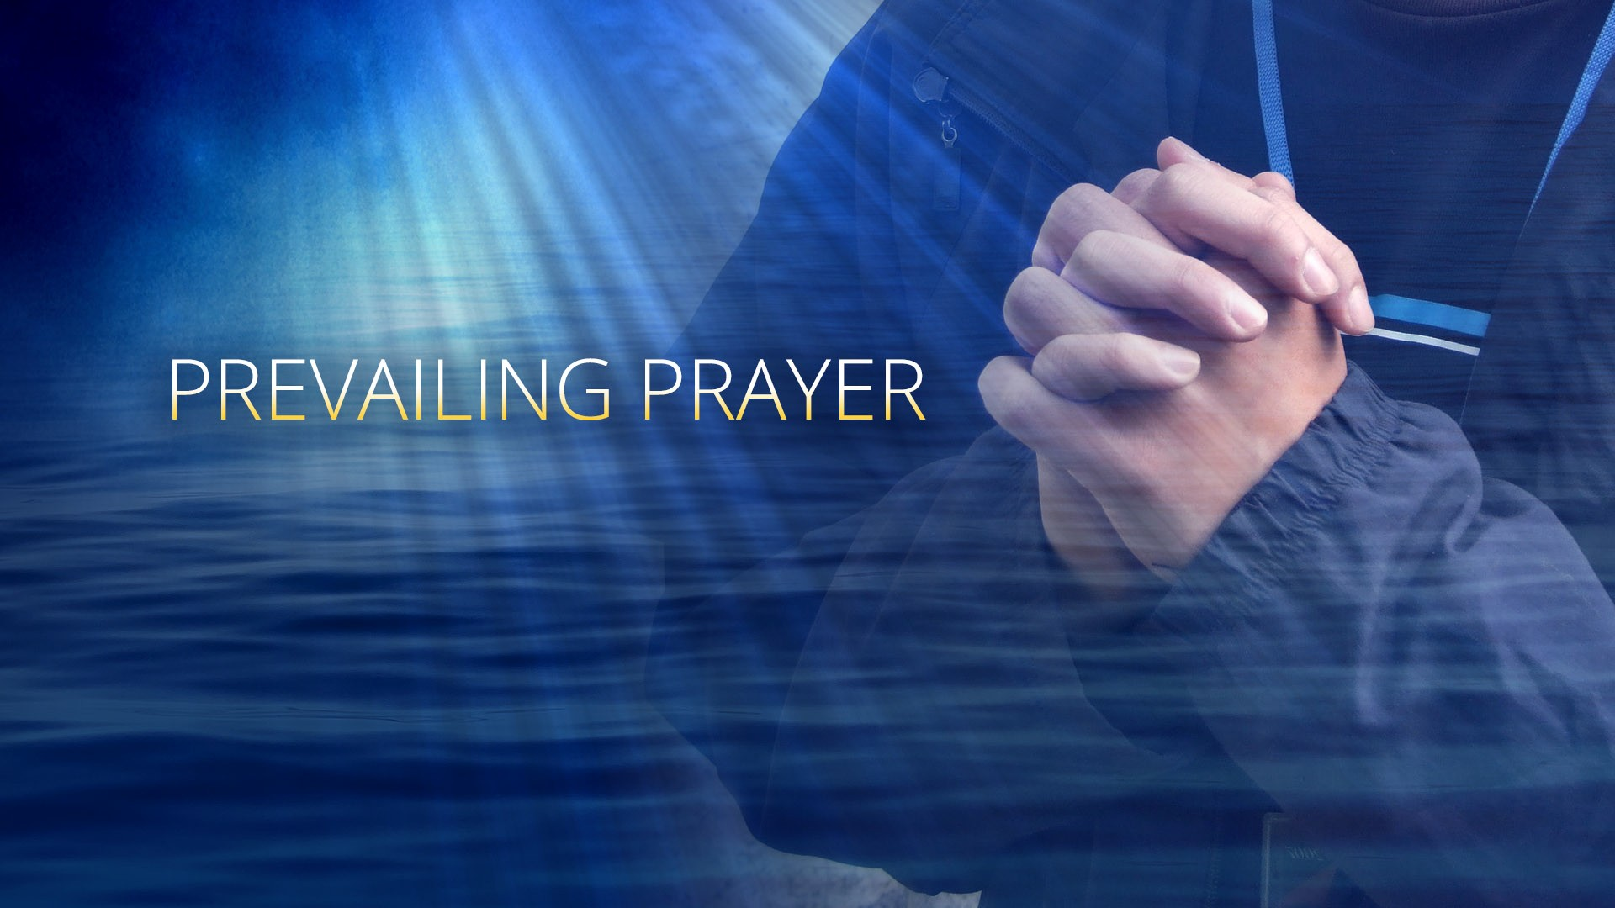

Slide 59
A revival of true godliness among us is
the greatest and most urgent of all our needs.
To seek this should be our first work…
Last Day Events Ch. 13 “Tha Latter Rain” (1SM pg 121)

Slide 60
There must be earnest effort to obtain the blessing of the Lord, not because God is not willing to bestow His blessing upon us, but because we are unprepared to receive it…

Slide 61
Our heavenly Father is more willing to give
His Holy Spirit to them that ask Him,
than are earthly parents to give good gifts to their children…

Slide 62
But it is our work, by confession, humiliation, repentance, and earnest prayer, to fulfill the conditions upon which God has promised to grant us His blessing. A revival need be expected only in answer to prayer.
Last Day Events Ch. 13 “The Latter Rain”

Slide 63


Slide 64
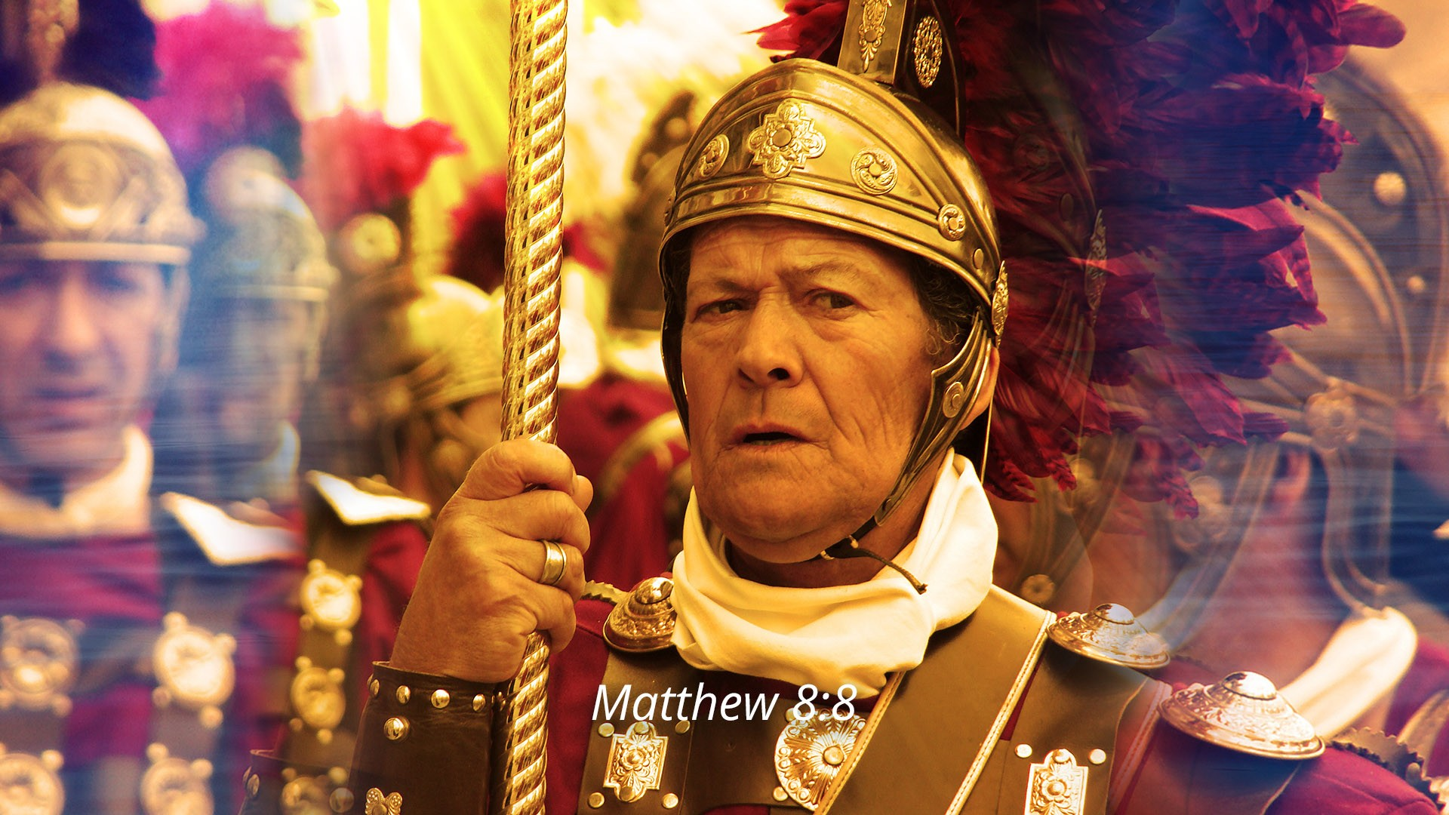

Slide 65
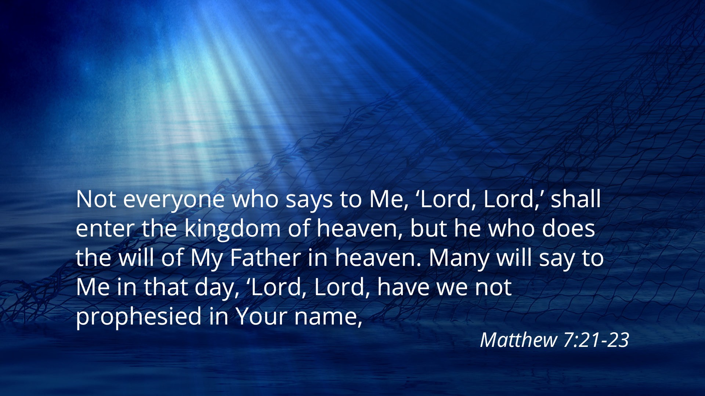

Slide 66
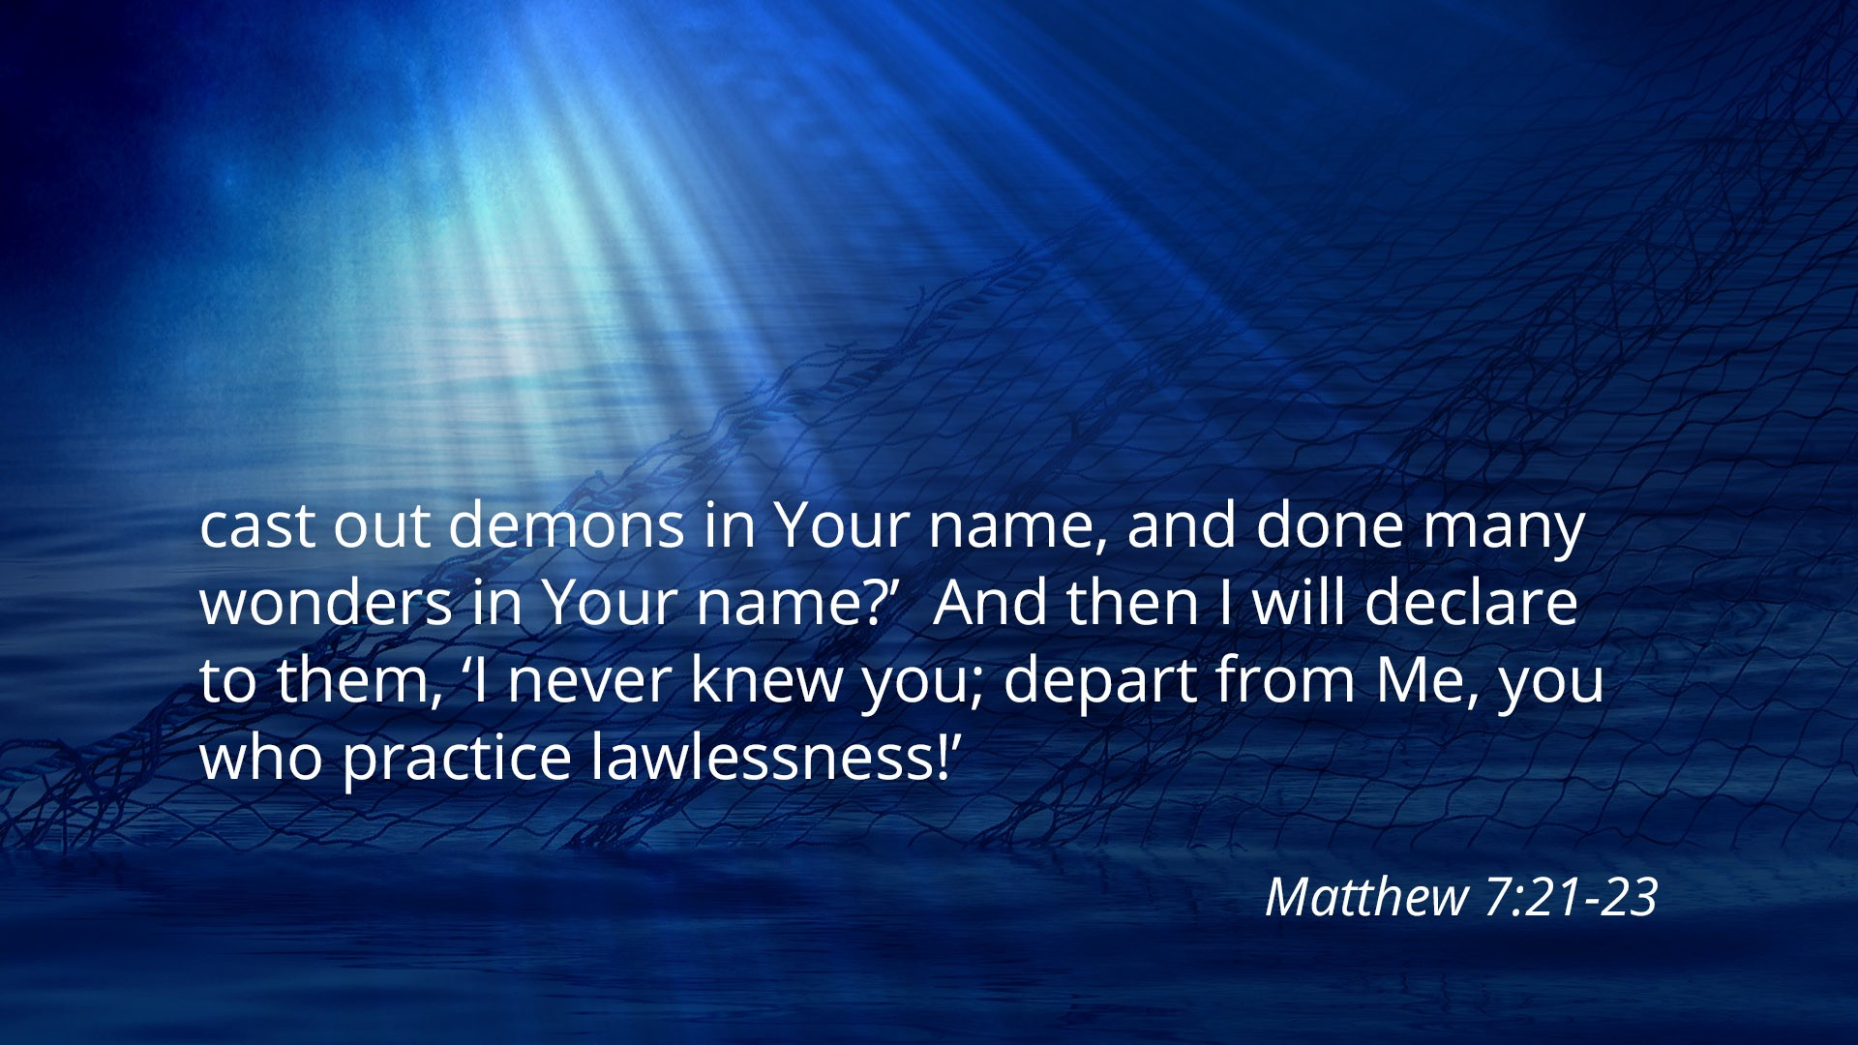

Slide 69
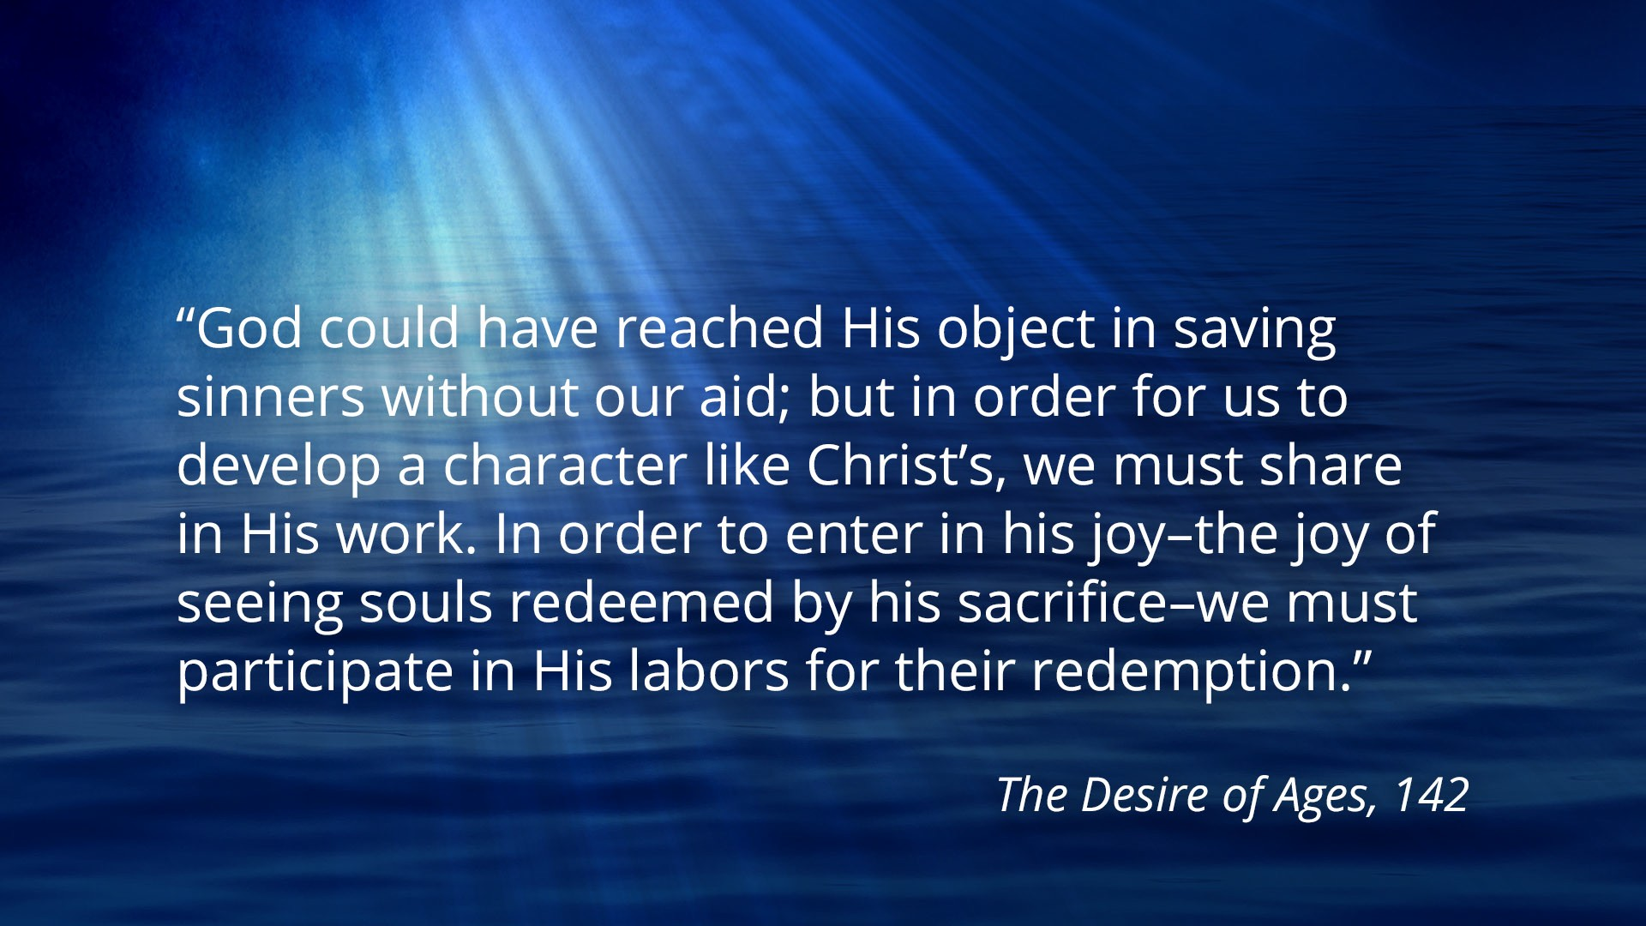

Slide 70
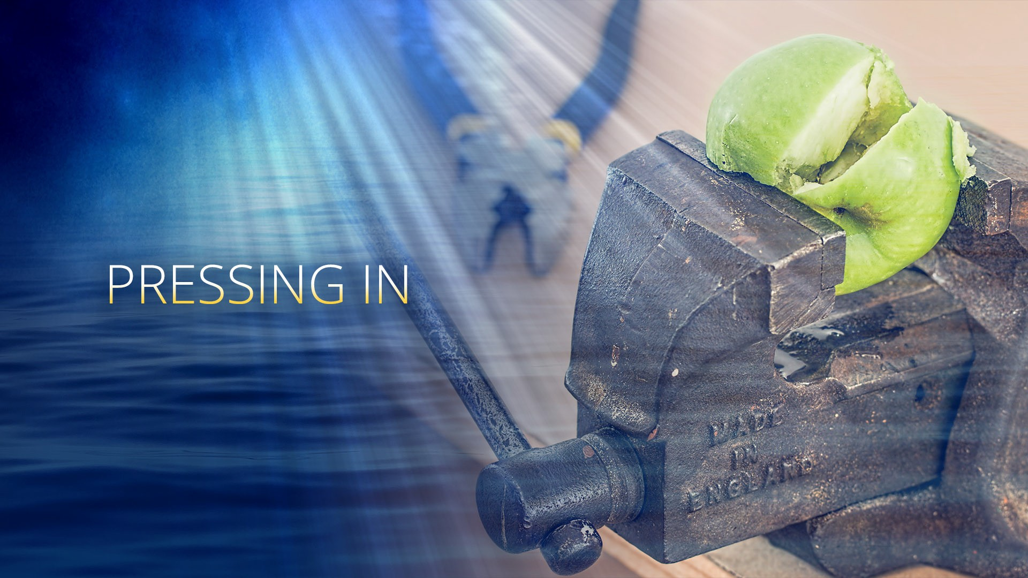

Slide 71
Steps to Christ
Ch. 8 ‘Growing Up Into Christ’
“Consecrate yourself to God in the morning; make this your very
first work. Let your prayer be,
“Take me, O Lord, as wholly Thine.
I lay all my plans at Thy feet.
Use me today in Thy service.
Abide with me, and let all my work be wrought in Thee…

Slide 72
This is a daily matter.
Each morning consecrate yourself to God for that day. Surrender all
your plans to Him, to be carried out or given up as His providence
shall indicate. Thus day by day you may be giving your life into the
hands of God, and thus your life will be molded more and more after
the life of Christ.”

Slide 73


Slide 74


Slide 75
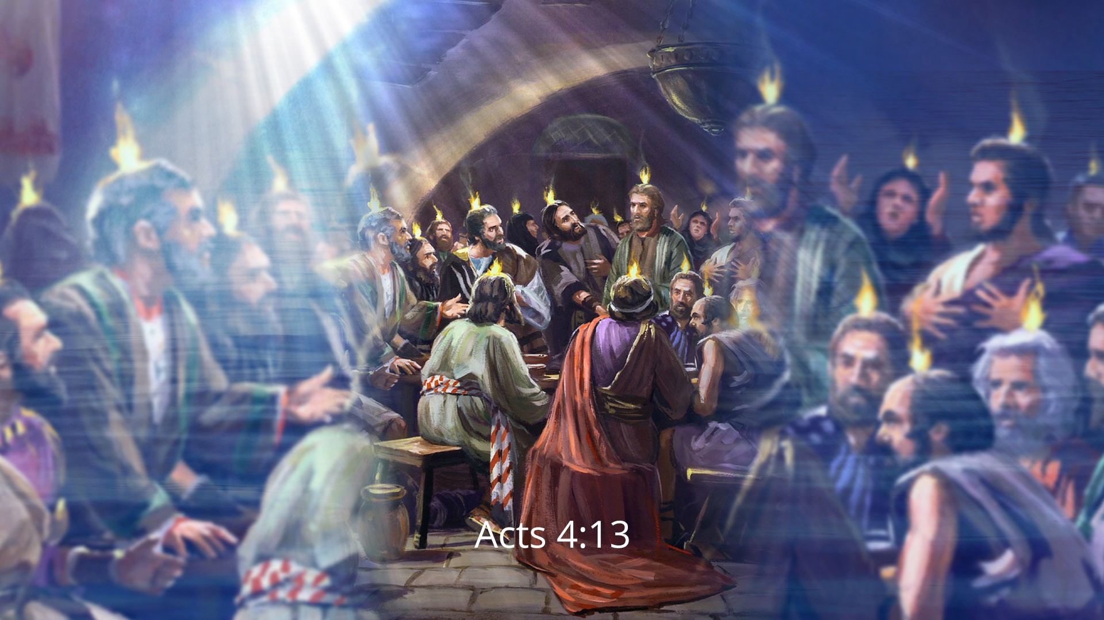

Slide 76
“When we have entire, wholehearted consecration to the service of Christ, God will recognize the fact by an outpouring of His Spirit without measure.”
LAST DAY EVENTS
Chapter 13 ‘The Latter Rain’

Slide 77

Notes:
Danny
Welcome
Introduce Carolynn and myself.
Housekeeping – toilets, drink, fire exits and hoses etc. Bibles on tables
Go through the Amazing disciple book each week quiz questions!
We don’t know everything, we are just sharing what we know. Speak up ask questions! We are all learning together.

