Slide 2
Giving Bible Studies

Slide 3
Baptism
March 22, 2008

Slide 4
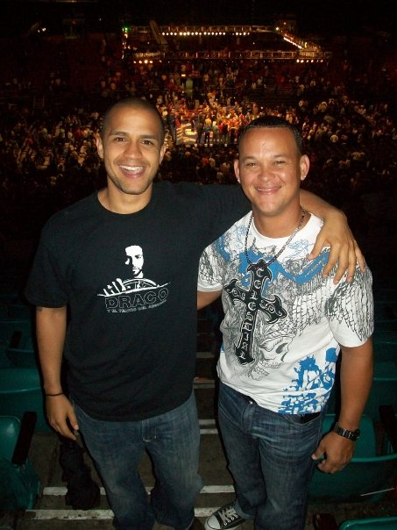

Slide 5
Evangelism Cycle
(Personal & Church)

Slide 6
Evangelism Cycle
(Personal & Church)
1. Daily Communion:
Prayer & Study Life

Slide 7
Evangelism Cycle
(Personal & Church)
1. Daily Communion:
Prayer & Study Life
2. Find Friends, Minister
to their Needs & Win
their Confidence & Trust
(Circle of Influence)

Slide 8
Evangelism Cycle
(Personal & Church)
1. Daily Communion:
Prayer & Study Life
2. Find Friends, Minister
to their Needs & Win
their Confidence & Trust
(Circle of Influence)
3. Share & Teach the Word
(Personal and Public)

Slide 9
Notes:
{

Slide 10
Go therefore and make disciples of all nations, baptizing them
& teaching them to observe all that I have commanded you.
Matthew 28:19,20

Slide 12
Notes:
2 Cor 3:18

Slide 13
Church Manual Revision 2015
Church Members Chap. 6
Baptism pg. 3. 4
Thorough instruction and public examination of the candidates
“Candidates should receive biblical instruction, individually or in a baptismal class, regarding the Fundamental Beliefs and practices of the Church and about the responsibilities of membership…

Slide 14
“The test of discipleship is not applied as strictly as it should be applied to those who present themselves for baptism. It must be known if they are simply taking the name of Seventh-day Adventists, or if they are taking the side of the Lord, to come out of the world and separate themselves from it and not touch the unclean….

Slide 15
Before baptism, the experience of the candidates should be thoroughly examined. Give this test, not in a cold, aloof manner, but kindly and tenderly, pointing new converts to the Lamb of God who takes away the sin of the world. Let candidates for baptism be made aware of the requirements of the gospel." (6T 101).
Church Manual Revision 2015
Church Members Chap. 6

Slide 16
Notes:
2 Cor 3:18

Slide 17
So faith comes from hearing, and hearing,
by the Word of God.
Romans 1:17

Slide 18
Sanctify them through
thy truth: thy word is truth.
John 17:17

Slide 19
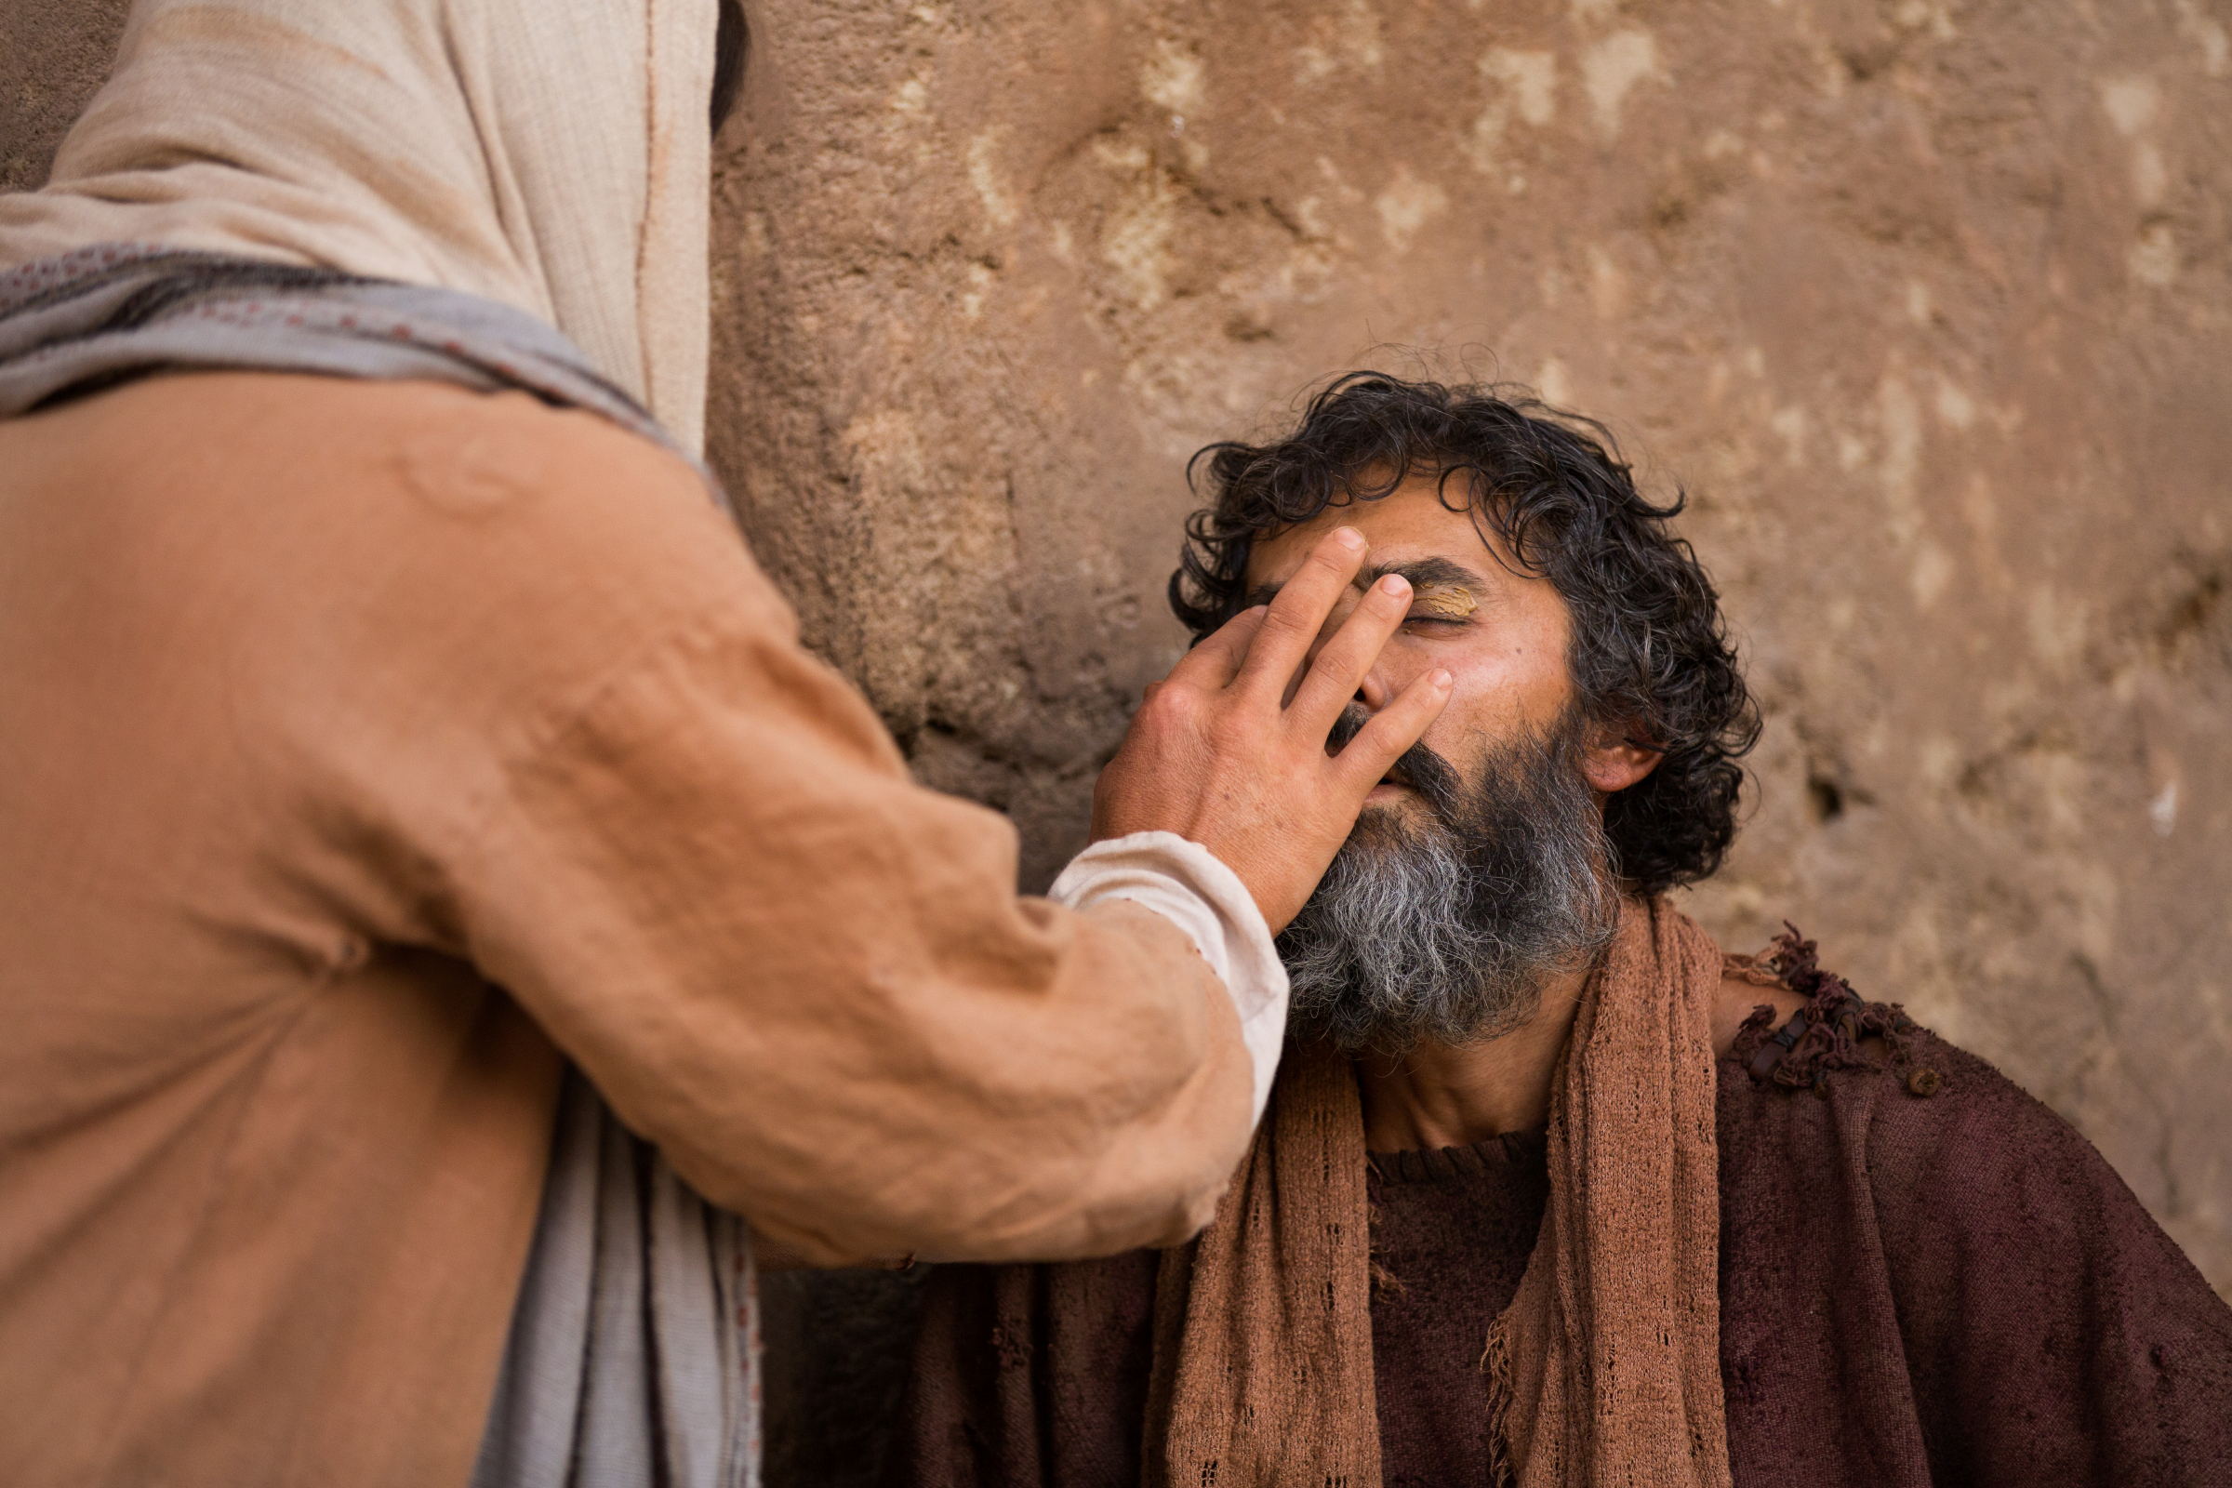

Slide 20
“Many read the Scriptures without understanding their true meaning. All over the world, there are men and women who stare at the sky. Prayers, tears and questions flow from souls longing for light in supplication for grace and for the reception of the Holy Spirit. Many are on the threshold of the kingdom, waiting only to be incorporated into it.”
Acts of the Apostles
Chap. 11 - The Gospel in Samaria

Slide 22
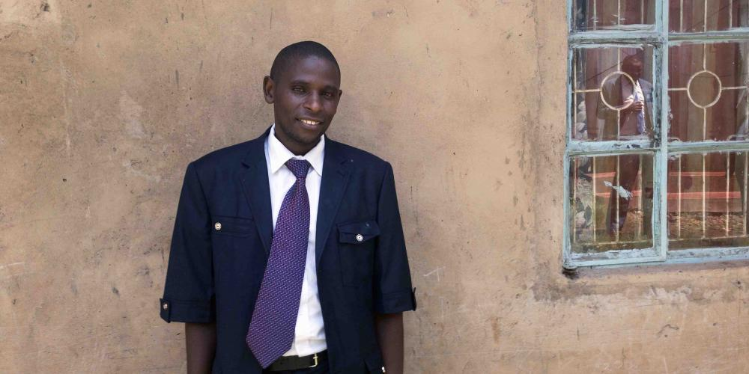

Slide 23
He who begins with a little knowledge, in a humble way, and tells what he knows, while seeking diligently for further knowledge, will find the whole heavenly treasure awaiting his demand. The more he seeks to impart light, the more light he will receive…

Slide 24
..The more one tries to explain the word of God to others, with a love for souls, the plainer it becomes to himself.
The more we use our knowledge and exercise our powers, the more knowledge and power we shall have.
Christ Object Lessons pg 354

Slide 26
Where should we start?
1. Use the church visitor list
2. Missing church members
3. Spouses or relatives of members of the church
4. Circle of Influence
5. Door to Door Outreach

Slide 27
6. People who have participated or attended talks, health fairs, previous campaigns...
7. Summer Canvassing Programs
8. Contacts by mail, social networks,
TV ads, radio...
9. Other options…

Slide 28
4 principles to win someone
over for Christ:

Slide 29
4 principles to win someone
over for Christ:
Prayer

Slide 30
4 principles to win someone
over for Christ:
Prayer
Love them (Respect their decisions)

Slide 31
4 principles to win someone
over for Christ:
Prayer
Love them (Respect their decisions)
Minister to their needs

Slide 32
4 principles to win someone
over for Christ:
Prayer
Love them (Respect their decisions)
Minister to their needs
Be a witness!

Slide 34
Three Principles for Giving
biblical studies:

Slide 35
Three Principles for Giving
biblical studies:
1. Always present Jesus first!

Slide 36
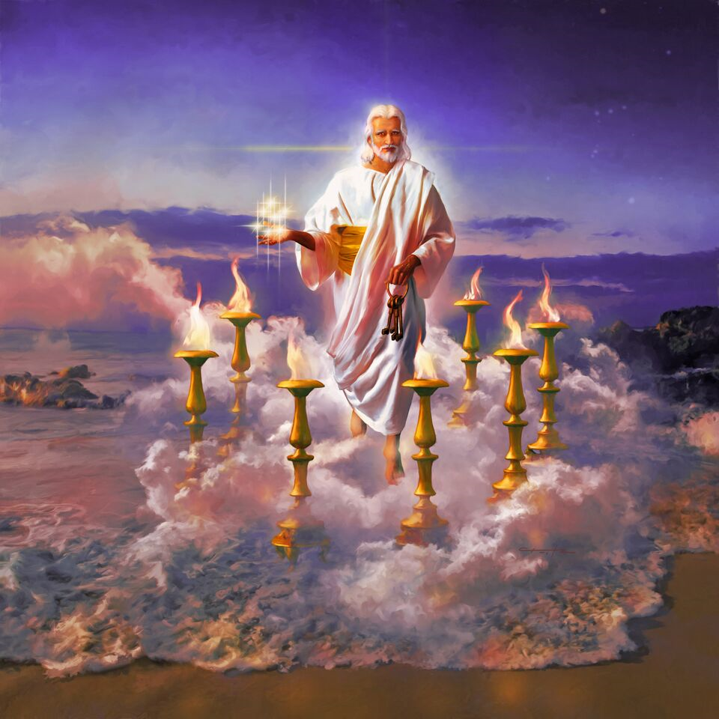

Slide 37
Three Principles for Giving
biblical studies:
1. Always present Jesus first!
2. Reveal Truth gradually.

Slide 38
Before knocking down their shackle of lies, build them
a castle of Truth!

Slide 39
Three Principles for Giving
biblical studies:
1. Always present Jesus first!
2. Reveal Truth gradually.
3. Regularly make appeals.

Slide 42
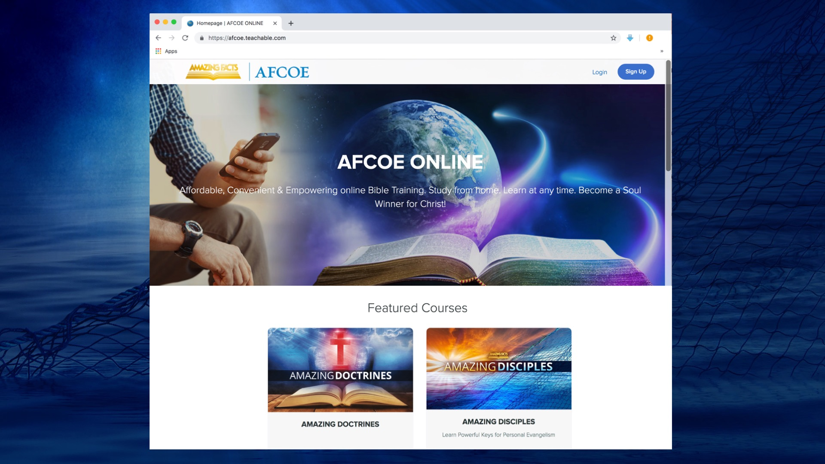

Slide 45
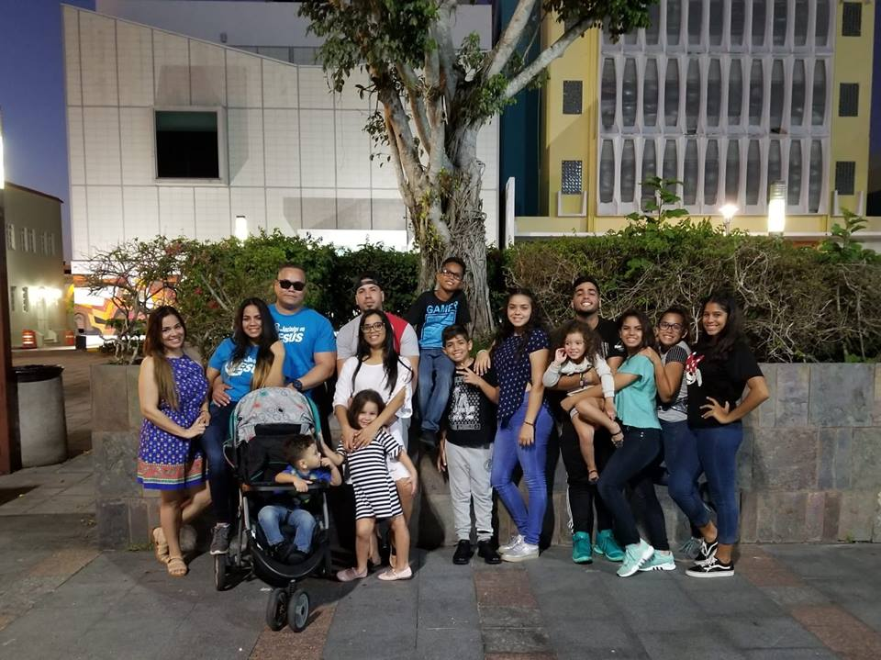

Slide 47
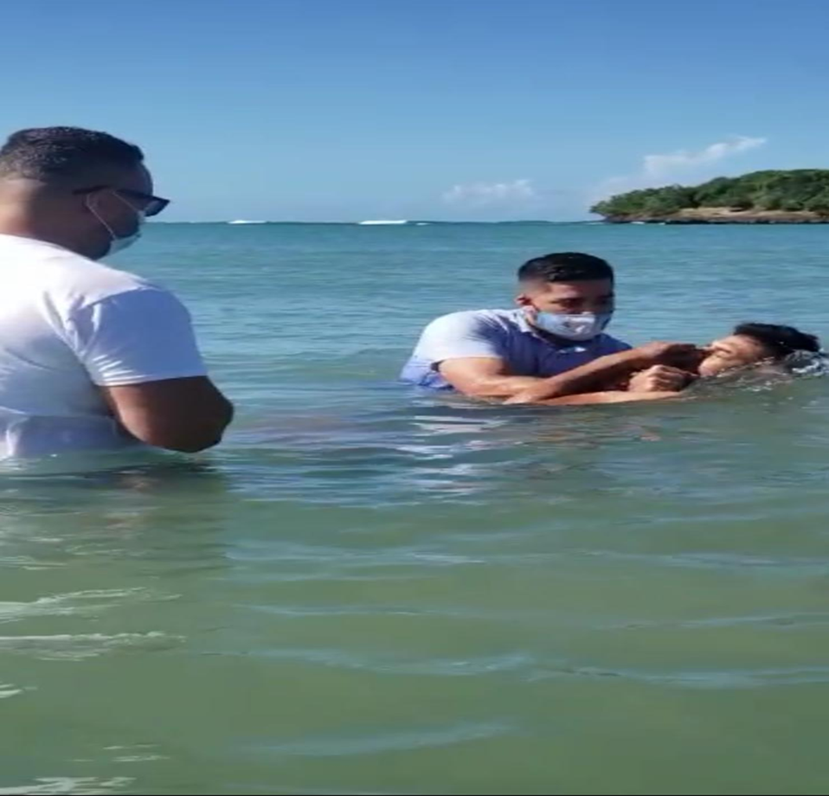

Slide 49
Evangelism Cycle
(Personal & Church)
4. Baptize, Nurture & Train New Believers
1. Daily Communion:
Prayer & Study Life
2. Find Friends, Minister
to their Needs & Win
their Confidence & Trust
(Circle of Influence)
3. Share & Teach the Word
(Personal and Public)

Slide 51
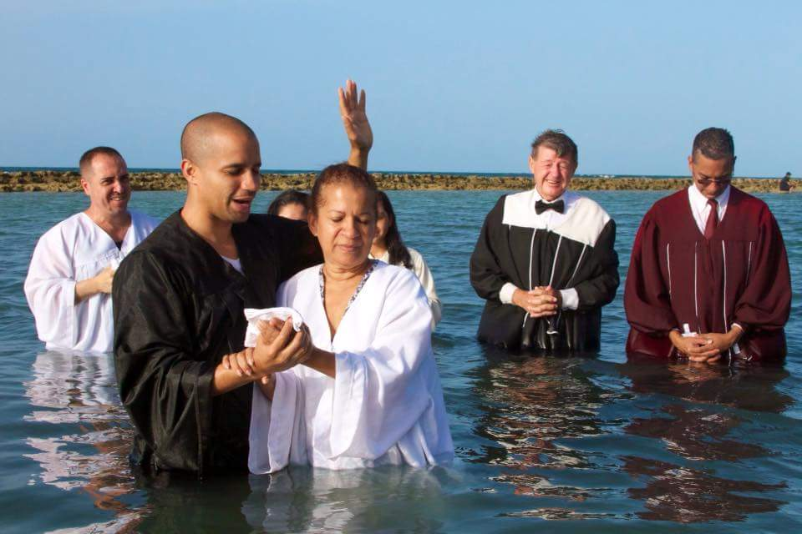

Slide 52
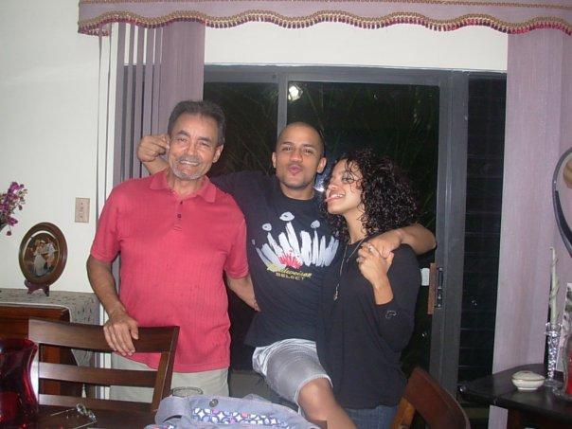

Slide 53
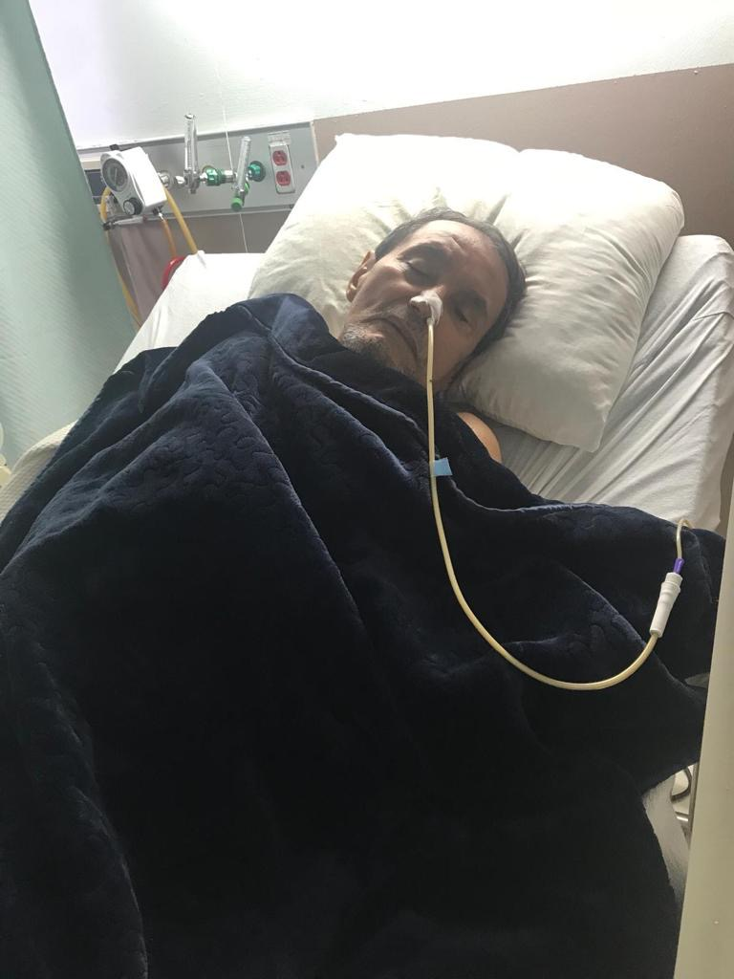
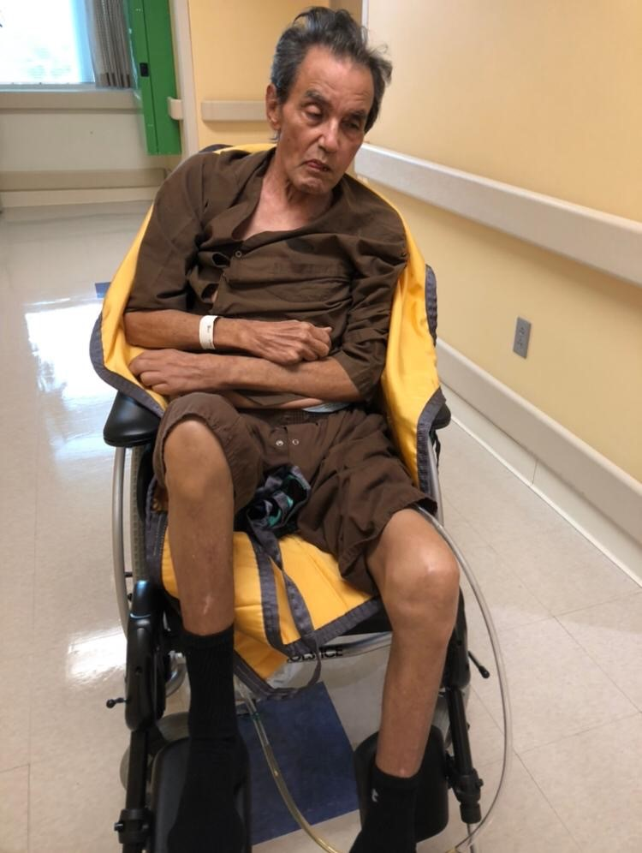

Slide 54
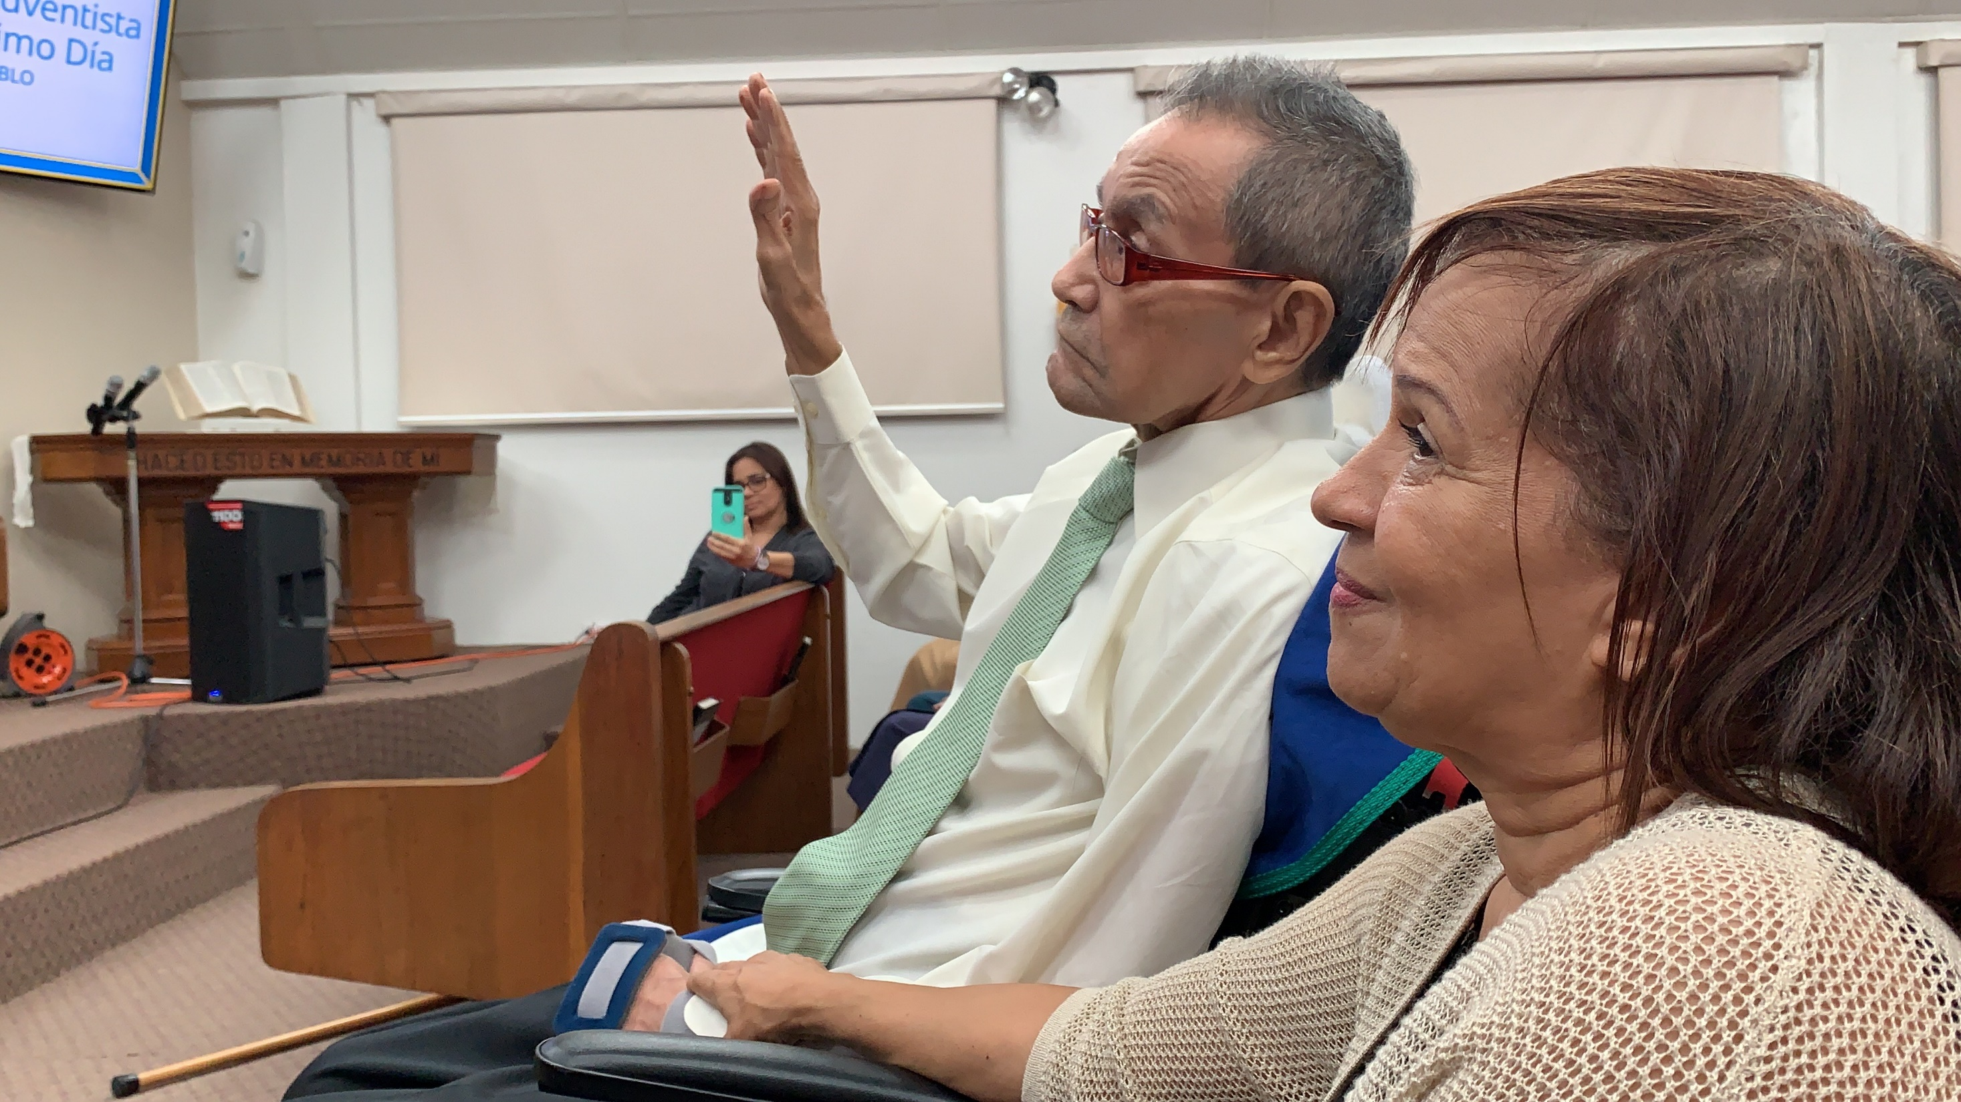

Slide 55
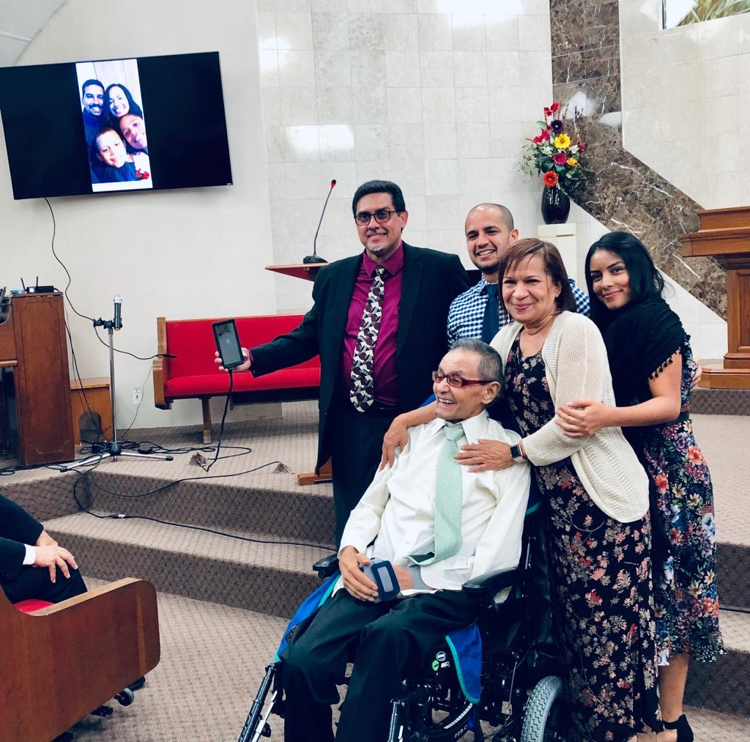

Slide 56
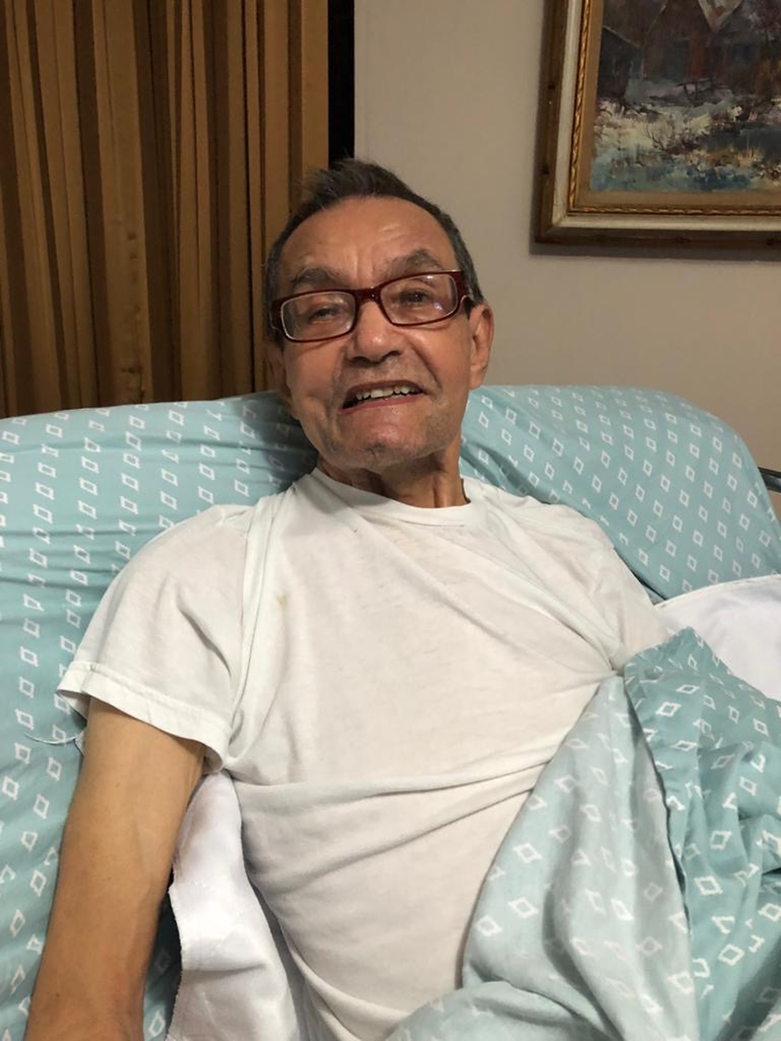

Slide 57
Evangelism Cycle
(Personal & Church)
4. Baptize, Nurture & Train New Believers
1. Daily Communion:
Prayer & Study Life
2. Find Friends, Minister
to their Needs & Win
their Confidence & Trust
(Circle of Influence)
3. Share & Teach the Word
(Personal and Public)

Slide 59
Reflection
If this church closed its doors tomorrow,
would your community notice the absence?
Are we having an impact in our community?
Consider how your church is collectively meeting the social, spiritual, emotional,
and physical needs around.
Am I contributing or just overserving?

Slide 60
Your AFCOE Challenge:
Do your neighbors know you? Your co-workers?
Have you approached and interacted with them to pray and see what their needs are?
Do they know that they can count on you to pray and intercede? Now is a perfect opportunity to go pray with them and see what their needs and are.

